Slide 1
Efficient High Performance Computing in the Cloud Keynote, VTDC’15
Dr. Abhishek Gupta
PhD, University of Illinois at Urbana Champaign
gupta59@Illinois.edu
06/15/2015

Slide 2
What is HPC?
Notes:
High Performance Computing (HPC) refers to the practice of aggregating computing power
to deliver much higher performance than typical desktop/laptop computers with the goals
of solving computationally intensive applications in science, engineering, or business. HPC
has traditionally been restricted to a niche segment comprising scientists who use super-
computers at national laboratories to enhance human knowledge by understanding how the
universe works. They use the tremendous computational power to understand how scientic
phenomena operate and evolve in scientic elds such as cosmology, molecular dynamics,
quantum chemistry, climate, and human genetics. More recently, HPC is also being used in
industry for business and analytics. According to November 2013 top500 list, 56.4% of top
500 supercomputing systems are used by industry

Slide 3
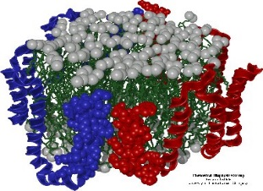
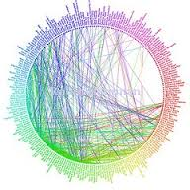
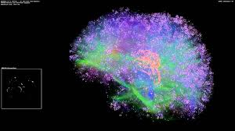
HPC
Computationally intensive applications
Aggregating computing power
HPC traditionally restricted to a niche segment - few influential labs. Why?
Notes:
High Performance Computing (HPC) refers to the practice of aggregating computing power
to deliver much higher performance than typical desktop/laptop computers with the goals
of solving computationally intensive applications in science, engineering, or business. HPC
has traditionally been restricted to a niche segment comprising scientists who use super-
computers at national laboratories to enhance human knowledge by understanding how the
universe works. They use the tremendous computational power to understand how scientic
phenomena operate and evolve in scientic elds such as cosmology, molecular dynamics,
quantum chemistry, climate, and human genetics. More recently, HPC is also being used in
industry for business and analytics. According to November 2013 top500 list, 56.4% of top
500 supercomputing systems are used by industry

Slide 4
What is Cloud Computing?

Slide 5
On-demand Self-service
Broad Network Access
Measured Service
Rapid Elasticity
Resource Pooling (Multi-tenancy)
Public
Private
Hybrid
Community
Essential characteristics
Deployment Models
Cloud Computing
Service Models
Software
(SaaS)
Platform (PaaS)
Infrastructure (IaaS)
Applications running on cloud infrastructure,
Examples - Google Apps, Salesforce
Computing platforms including programming language execution framework, database, OS.
Examples - Google App Engine, Microsoft Azure
Physical or virtual computing infrastructure, processing, storage, network.
Examples - Amazon EC2, HP cloud
Notes:
What is cloud, what is HPC
A model for provinding computing as a service .. Shared pool of resources..
Cloud computing is a model for enabling ubiquitous, convenient, on-demand network access to a shared
pool of configurable computing resources (e.g., networks, servers, storage, applications, and services) that
can be rapidly provisioned and released with minimal management effort or service provider interaction.
This cloud model is composed of five essential characteristics, three service models, and four deployment
models.

Slide 6
What do we mean by
HPC +/in Cloud

Slide 7
Marriage of two very different computing paradigm
Learn from best known principles and apply to each other

Slide 8
HPC and Clouds (1)
Public Clouds
Computationally intensive applications
HPC in public clouds: Cloud as a solution to HPC users’ needs
Notes:
High Performance Computing (HPC) refers to the practice of aggregating computing power
to deliver much higher performance than typical desktop/laptop computers with the goals
of solving computationally intensive applications in science, engineering, or business. HPC
has traditionally been restricted to a niche segment comprising scientists who use super-
computers at national laboratories to enhance human knowledge by understanding how the
universe works. They use the tremendous computational power to understand how scientic
phenomena operate and evolve in scientic elds such as cosmology, molecular dynamics,
quantum chemistry, climate, and human genetics. More recently, HPC is also being used in
industry for business and analytics. According to November 2013 top500 list, 56.4% of top
500 supercomputing systems are used by industry

Slide 9
HPC and Clouds (2)
Customized HPC Clouds
Computationally intensive applications
Custom “HPC-clouds”
Notes:
High Performance Computing (HPC) refers to the practice of aggregating computing power
to deliver much higher performance than typical desktop/laptop computers with the goals
of solving computationally intensive applications in science, engineering, or business. HPC
has traditionally been restricted to a niche segment comprising scientists who use super-
computers at national laboratories to enhance human knowledge by understanding how the
universe works. They use the tremendous computational power to understand how scientic
phenomena operate and evolve in scientic elds such as cosmology, molecular dynamics,
quantum chemistry, climate, and human genetics. More recently, HPC is also being used in
industry for business and analytics. According to November 2013 top500 list, 56.4% of top
500 supercomputing systems are used by industry

Slide 10
HPC and Clouds (3)
Computationally intensive applications
Renting Supercomputer on a cloud model - virtualization, elasticity, pay-as-you-go model
Cloud technologies on existing HPC infrastructure
Notes:
High Performance Computing (HPC) refers to the practice of aggregating computing power
to deliver much higher performance than typical desktop/laptop computers with the goals
of solving computationally intensive applications in science, engineering, or business. HPC
has traditionally been restricted to a niche segment comprising scientists who use super-
computers at national laboratories to enhance human knowledge by understanding how the
universe works. They use the tremendous computational power to understand how scientic
phenomena operate and evolve in scientic elds such as cosmology, molecular dynamics,
quantum chemistry, climate, and human genetics. More recently, HPC is also being used in
industry for business and analytics. According to November 2013 top500 list, 56.4% of top
500 supercomputing systems are used by industry

Slide 11
HPC and Clouds (4)
Computationally intensive applications
Public Clouds
Hybrid HPC+cloud infrastructure – bursting to cloud
Notes:
High Performance Computing (HPC) refers to the practice of aggregating computing power
to deliver much higher performance than typical desktop/laptop computers with the goals
of solving computationally intensive applications in science, engineering, or business. HPC
has traditionally been restricted to a niche segment comprising scientists who use super-
computers at national laboratories to enhance human knowledge by understanding how the
universe works. They use the tremendous computational power to understand how scientic
phenomena operate and evolve in scientic elds such as cosmology, molecular dynamics,
quantum chemistry, climate, and human genetics. More recently, HPC is also being used in
industry for business and analytics. According to November 2013 top500 list, 56.4% of top
500 supercomputing systems are used by industry

Slide 12
HPC and Clouds
HPC in public clouds
Cloud as a solution to HPC users’ needs
HPC as a service – ubiquity
Cloud technologies on existing HPC infrastructure
Virtualization, elasticity, pay-as-you-go model
Renting Supercomputer on a cloud model
Custom “HPC-clouds”
Hybrid HPC+cloud – bursting to cloud
Public cloud very appealing for HPC users, why?
Notes:
Cloud-aware HPC runtime
HPC-aware Clouds

Slide 13
Motivation: Why Clouds for HPC ?
Rent vs. own, pay-as-you-go
No startup/maintenance cost, cluster create time
Elastic resources
No risk e.g. in under-provisioning
Prevents underutilization
Benefits of virtualization
Flexibility and customization
Security and isolation
Migration and resource control
Cloud for HPC: A cost-effective and timely solution? Multiple providers – Infrastructure as a Service

Slide 14
Research Questions
HPC in cloud
What (applications), why (benefits), who (users)
How:
Bridge HPC-cloud gap
Improve HPC performance
Improve cloud utilization=> Reduce cost
Notes:
Prior work focus only on perf eval.. We take holistic perspective.. . Doe Megellan project
Cloud provider + User perspective
HPC-aware Cloud + Cloud-aware HPC
Performance achieved on cloud vs. supercomputer?
The bigger and more important question: why and who should choose (or not choose) cloud for HPC, for what applications, and how should cloud be used for HPC?
2 ways how : improve performance or reduce cost by improving utilization

Slide 15
Quick Philosophical Analogy

Slide 16
Traditional Belief
Plants (HPC applications)
Typical HPC platforms
Typical cloud
Rotten plants
Flowers

Slide 17
Our Belief
Plants (HPC applications)
Typical HPC platforms
Typical cloud
Some plants may flourish
Flowers

Slide 18
Make HPC Cloud-Aware
Plants (HPC applications)
Typical HPC platforms
Typical cloud
Flowers

Slide 19
Plants (HPC applications)
Make Clouds HPC-Aware
Typical HPC platforms
Typical cloud
Flowers

Slide 20
Outline
Performance analysis
HPC cloud divide
Bridging the gap between HPC and cloud
HPC-aware clouds
Application-aware cloud scheduler and VM consolidation
Cloud-aware HPC
Dynamic load balancing: improve HPC performance
Parallel runtime for malleable jobs: improve utilization
Models, cost analysis and multiple platforms in cloud
Lessons, conclusions, impact, and future work
Notes:
Increase resource util ➔ cost savings
They appear to be conflicting but as we will see, we can actually do good on both
Cloud offerings use application-agnostic VM placement
Poor performance of HPC apps in Cloud
Cost savings potential through application aware consolidation

Slide 21
Experimental Testbed and Applications
Platform/ Resource | Ranger (TACC) | Taub (UIUC) | Open Cirrus (HP) | HPC-optimized Cloud (EC2-CC) | Private Cloud | Public Cloud
Network | Infiniband (10Gbps) | Voltaire QDR Infiniband | 10 Gbps Ethernet internal; 1 Gbps Ethernet x-rack | Xen HVM hypervisor, same placement group (10Gbps Ethernet) | Emulated network KVM hypervisor (1Gbps Ethernet) | Emulated network KVM hypervisor (1Gbps Ethernet)
NAS Parallel Benchmarks class B (NPB3.3-MPI)
NAMD - Highly scalable molecular dynamics
ChaNGa - Cosmology, N-body
Sweep3D - A particle in ASCI code
Jacobi2D - 5-point stencil computation kernel
Nqueens - Backtracking state space search
Notes:
Todo: Change table, keep only relevant aspects which I will discuss
Details in report

Slide 22
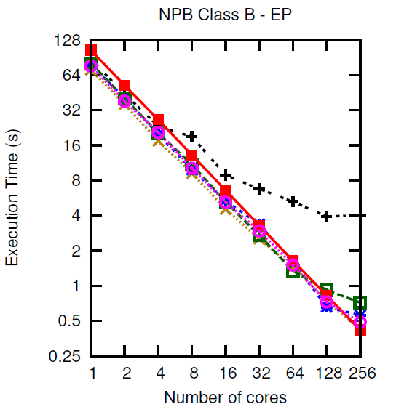
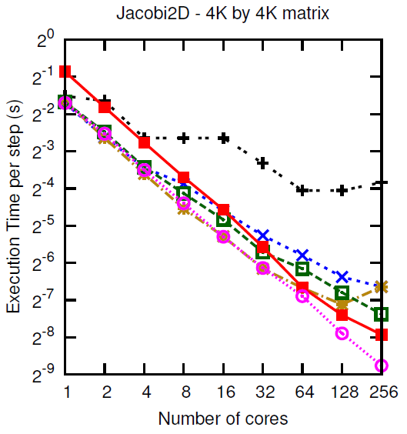
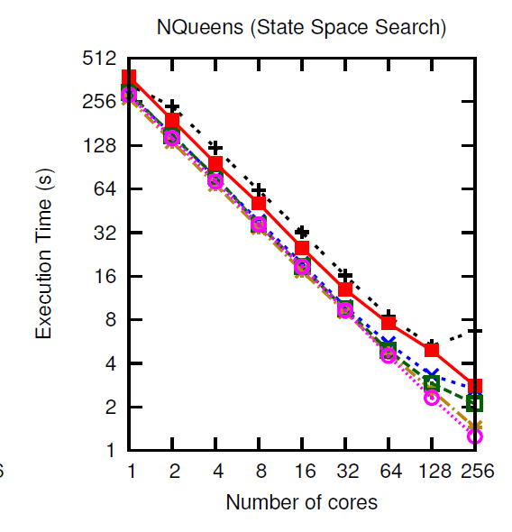
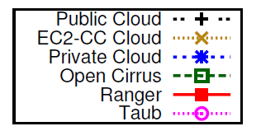
Performance (1/3)
Some applications cloud-friendly
Notes:
Execution Time vs. Number of cores (strong scaling for all except Sweep3D) for different applications. All
applications scale very well on Taub and Ranger and moderately well on Open Cirrus. On Private Cloud, IS does not
scale at all, LU and NAMD stop scaling after 32 cores whereas EP, Jacobi2D and NQueens scale well. Public cloud
exhibits poor scalability.
For NPB, we present results for only Embarrassingly
parallel (EP), LU solver (LU), and Integer sort (IS)
benchmarks due to space constraints. The first observation is
the difference in sequential performance: Ranger takes almost
twice as long as the other platforms, primarily because of the
older and slower processors.
The slope of the curve shows how
the applications scale on different platforms. Despite the poor
sequential speed, Ranger’s performance crosses Open Cirrus,
private cloud and public cloud for some applications at around
32 cores, yielding a much more linearly scalable parallel
performance. We investigated the reasons for better scalability
of these applications on Ranger using application profiling,
performance tools and microbenchmarking the platforms and
found that network performance is a dominant factor (section
IV-A). While all applications scale well on Ranger and
Taub, some applications, especially the NPB IS (Integer Sort)
benchmark, fail to scale on the clouds and Open Cirrus. IS
is a communication intensive benchmark and involves data
reshuffling and permutation operations for sorting. Sweep3D
also exhibits poor weak scaling after 4–8 cores on cloud. Other
communication intensive applications such as LU, NAMD
and ChaNGa also stop scaling on private cloud around 32
cores, but do reasonably well on Open Cirrus, because of the
impact of virtualization on network performance (which we
confirm below). The remaining applications, EP, Jacobi2D,
and NQueens, scale well on all the platforms up to 256 cores
except the public cloud where most applications suffer a hit
above 4 cores. On public cloud, we used VM instances with
4 virtual cores, hence there is no inter-VM communication
up to 4 cores, resulting in good parallel scaling and a sudden
performance penalty as the communication starts happening
across VMs.
Split into 3 sub-plots.
-- apps doing well on all
-- IS
-- all except public and private (and diff bw public, private)
---- what are the reasons??
Comm – why ?? (we went ahead?? – what factors – thin VM, … amazon ec2 clouds…) – extensive researched…
Public and private? … not much has been done for these?? – attribute this to multi-tenancy, scheduling..
Cost

Slide 23
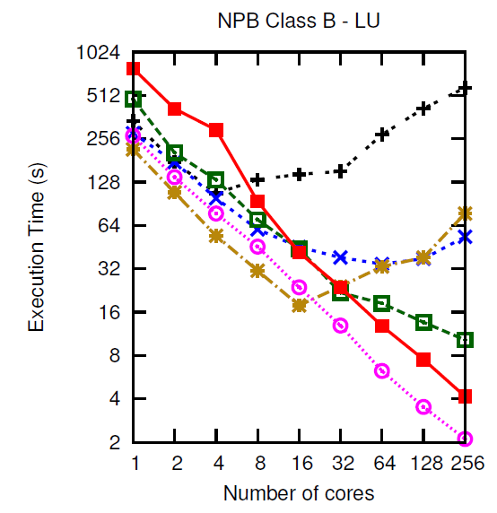
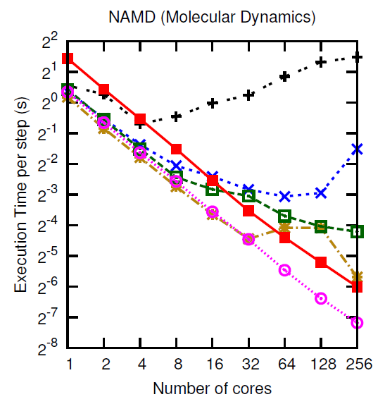
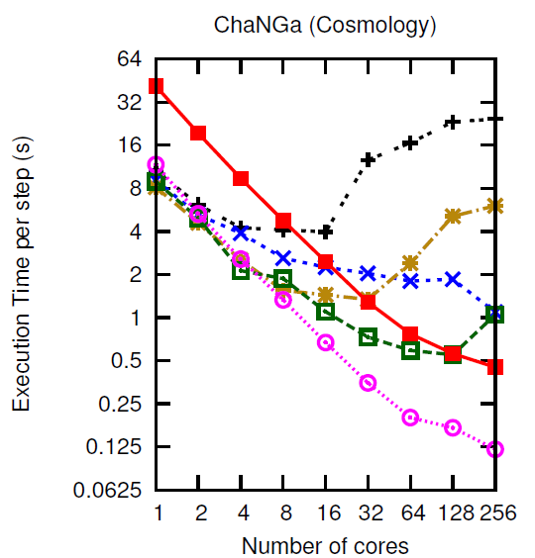
Performance (2/3)
NAMD scales on EC2-CC
Some applications scale till 16-64 cores
Notes:
Execution Time vs. Number of cores (strong scaling for all except Sweep3D) for different applications. All
applications scale very well on Taub and Ranger and moderately well on Open Cirrus. On Private Cloud, IS does not
scale at all, LU and NAMD stop scaling after 32 cores whereas EP, Jacobi2D and NQueens scale well. Public cloud
exhibits poor scalability.
For NPB, we present results for only Embarrassingly
parallel (EP), LU solver (LU), and Integer sort (IS)
benchmarks due to space constraints. The first observation is
the difference in sequential performance: Ranger takes almost
twice as long as the other platforms, primarily because of the
older and slower processors.
The slope of the curve shows how
the applications scale on different platforms. Despite the poor
sequential speed, Ranger’s performance crosses Open Cirrus,
private cloud and public cloud for some applications at around
32 cores, yielding a much more linearly scalable parallel
performance. We investigated the reasons for better scalability
of these applications on Ranger using application profiling,
performance tools and microbenchmarking the platforms and
found that network performance is a dominant factor (section
IV-A). While all applications scale well on Ranger and
Taub, some applications, especially the NPB IS (Integer Sort)
benchmark, fail to scale on the clouds and Open Cirrus. IS
is a communication intensive benchmark and involves data
reshuffling and permutation operations for sorting. Sweep3D
also exhibits poor weak scaling after 4–8 cores on cloud. Other
communication intensive applications such as LU, NAMD
and ChaNGa also stop scaling on private cloud around 32
cores, but do reasonably well on Open Cirrus, because of the
impact of virtualization on network performance (which we
confirm below). The remaining applications, EP, Jacobi2D,
and NQueens, scale well on all the platforms up to 256 cores
except the public cloud where most applications suffer a hit
above 4 cores. On public cloud, we used VM instances with
4 virtual cores, hence there is no inter-VM communication
up to 4 cores, resulting in good parallel scaling and a sudden
performance penalty as the communication starts happening
across VMs.
Split into 3 sub-plots.
-- apps doing well on all
-- IS
-- all except public and private (and diff bw public, private)
---- what are the reasons??
Comm – why ?? (we went ahead?? – what factors – thin VM, … amazon ec2 clouds…) – extensive researched…
Public and private? … not much has been done for these?? – attribute this to multi-tenancy, scheduling..
Cost

Slide 24
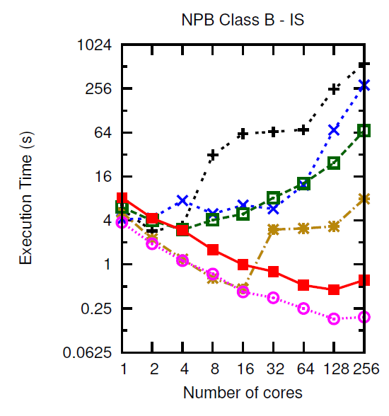
Performance (3/3)
Some applications cannot survive in cloud
Notes:
Execution Time vs. Number of cores (strong scaling for all except Sweep3D) for different applications. All
applications scale very well on Taub and Ranger and moderately well on Open Cirrus. On Private Cloud, IS does not
scale at all, LU and NAMD stop scaling after 32 cores whereas EP, Jacobi2D and NQueens scale well. Public cloud
exhibits poor scalability.
For NPB, we present results for only Embarrassingly
parallel (EP), LU solver (LU), and Integer sort (IS)
benchmarks due to space constraints. The first observation is
the difference in sequential performance: Ranger takes almost
twice as long as the other platforms, primarily because of the
older and slower processors.
The slope of the curve shows how
the applications scale on different platforms. Despite the poor
sequential speed, Ranger’s performance crosses Open Cirrus,
private cloud and public cloud for some applications at around
32 cores, yielding a much more linearly scalable parallel
performance. We investigated the reasons for better scalability
of these applications on Ranger using application profiling,
performance tools and microbenchmarking the platforms and
found that network performance is a dominant factor (section
IV-A). While all applications scale well on Ranger and
Taub, some applications, especially the NPB IS (Integer Sort)
benchmark, fail to scale on the clouds and Open Cirrus. IS
is a communication intensive benchmark and involves data
reshuffling and permutation operations for sorting. Sweep3D
also exhibits poor weak scaling after 4–8 cores on cloud. Other
communication intensive applications such as LU, NAMD
and ChaNGa also stop scaling on private cloud around 32
cores, but do reasonably well on Open Cirrus, because of the
impact of virtualization on network performance (which we
confirm below). The remaining applications, EP, Jacobi2D,
and NQueens, scale well on all the platforms up to 256 cores
except the public cloud where most applications suffer a hit
above 4 cores. On public cloud, we used VM instances with
4 virtual cores, hence there is no inter-VM communication
up to 4 cores, resulting in good parallel scaling and a sudden
performance penalty as the communication starts happening
across VMs.
Split into 3 sub-plots.
-- apps doing well on all
-- IS
-- all except public and private (and diff bw public, private)
---- what are the reasons??
Comm – why ?? (we went ahead?? – what factors – thin VM, … amazon ec2 clouds…) – extensive researched…
Public and private? … not much has been done for these?? – attribute this to multi-tenancy, scheduling..
Cost

Slide 25
Performance Analysis
Co-relation: communication and performance
Communication-intensive applications perform poorly in clouds
CC2-EC2: Bandwidth sensitive ok, latency-sensitive not ok
Cloud message latencies (150-200μs) vs. supercomputers (4μs)
Bandwidths off by 2 orders of magnitude (10Gbps vs. 100Mbps)
Except : CC2-EC2 bandwidth comparable to supercomputers
Commodity network + virtualization overhead (e.g. ~100μs latency)
Thin VMs, Containers, CPU affinity
Grain size control and larger problem sizes
Noise and performance variability in cloud
Similar network performance for public and private cloud. Then, why does public cloud perform worse?
Scheduling policy allowed multi-tenancy
Infrastructure was heterogeneous
25
Notes:
ExtremeHPC: Extremely tightly coupled or topology sensitive
applications for which the best will be to provide
dedicated nodes, example – IS.
SyncHPC: Sensitive to interference, but less compared to
ExtremeHPC and can sustain small degree of interference
to get consolidation benefits, examples – LU, ChaNGa.
AsyncHPC: Asynchronous (and less communication sensitive)
and can sustain more interference than SyncHPC,
examples – EP, MapReduce applications.
NonHPC: Do not perform any communication, can sustain
more interference, and can be placed on heterogeneous
hardware, example – Web applications.

Slide 26
multi-tenancy and Heterogeneity Challenge
Multi-tenancy: Cloud providers run profitable business by improving utilization of underutilized resources
Cluster-level by serving large number of users,
Server-level by consolidating VMs of complementary nature
Heterogeneity: Cloud economics is based on:
Creation of a cluster from existing pool of resources and
Incremental addition of new resources.
Heterogeneity and multi-tenancy intrinsic in clouds, driven by cloud economics but
For HPC, one slow processor => all underutilized processors
Notes:
Heterogeneity, multi-tenancy are intrinsic from cost point of view but they result in perf degradation… so then how does economics work for hpc –clouds.. We evaluated the cost of running apps on cloud vs sc..

Slide 27
HPC-Cloud Divide Summary
HPC
Cloud
Performance
Dedicated execution
Homogeneity
HPC-optimized interconnects, OS
Not cloud-aware
Service, cost, utilization
Multi-tenancy
Heterogeneity
Commodity network, virtualization
Not HPC-aware
Mismatch: HPC requirements and cloud characteristics.
How to bridge this gap?
A. Gupta et al. “The Who, What, Why and How of High Performance Computing in the Cloud” in IEEE CloudCom 2013 Best Paper

Slide 28
Next …
HPC in
HPC-aware cloud
Challenges/Bottlenecks
Opportunities
Heterogeneity
Multi-tenancy
VM consolidation
Application-aware
Cloud schedulers
SCHEDULING/PLACEMENT
Notes:
Cloud offerings use application-agnostic VM placement
Poor performance of HPC apps in Cloud
Cost savings potential through application aware consolidation

Slide 29
VM Consolidation for HPC in Cloud (1)
HPC performance vs. Resource utilization
(prefers dedicated execution) (shared usage in cloud)?
Up to 23% savings
Can we improve utilization with acceptable performance penalty?
How much interference?
Notes:
Challenge:
Cross-Application Interference,
Sensitivity to network topology
Sensitivity to heterogeneity
-- cloud economics wants resource packing..
Scope: Improved Resource Utilization
Amazon EC2 – pack cluster compute and High Memory Instance = 23% cost savings

Slide 30
VM Consolidation for HPC in Cloud (2)
Experiment: Shared mode (2 apps on each node – 2 cores each on 4 core node) performance normalized wrt. dedicated mode
Challenge: Interference
4 VM per app
Scope
High is better
EP = Embarrassingly Parallel
LU = LU factorization
IS = Integer Sort
ChaNGa = Cosmology
Careful co-locations can actually improve performance. Why?
Correlation : LLC misses/sec and shared mode performance.
Notes:
Co-relation between LLC misses/sec and shared mode perf.
Apps with high LLC misses/s benefit when sharing node with apps with low LLC misses/s – e.g. LU
Apps with low LLC misses/s marginally affected when sharing node with apps with high LLC misses/s e.g. EP
But what about IS?
IS is network-intensive, so local vs. remote dominates

Slide 31
HPC-Aware Cloud Schedulers
1. Characterize applications along two dimensions
Cache intensiveness and network sensitivity
2. Co-locate applications with complementary profiles
Dedicated execution, topology- and hardware-awareness for extremely tightly-coupled HPC applications
~20% improvement
Multi-dimensional Online Bin Packing: Memory, CPU
Dimension aware heuristic
Cross application interference aware
45% performance improvement, interference < 8%, (OpenStack)
But, what about resource utilization?
Improve throughput by 32.3% (simulation using CloudSim)
31
A. Gupta, L. Kale, D. Milojicic, P. Faraboschi, and S. Balle, “HPC-Aware VM Placement in Infrastructure Clouds ,” at IEEE Intl. Conf. on Cloud Engineering IC2E ’13
Notes:
ExtremeHPC: Extremely tightly coupled or topology sensitive
applications for which the best will be to provide
dedicated nodes, example – IS.
SyncHPC: Sensitive to interference, but less compared to
ExtremeHPC and can sustain small degree of interference
to get consolidation benefits, examples – LU, ChaNGa.
AsyncHPC: Asynchronous (and less communication sensitive)
and can sustain more interference than SyncHPC,
examples – EP, MapReduce applications.
NonHPC: Do not perform any communication, can sustain
more interference, and can be placed on heterogeneous
hardware, example – Web applications.

Slide 32
Cloud-Aware
HPC in Cloud
Next …
Challenges/Bottlenecks
Opportunities
Heterogeneity
Multi-tenancy
Elasticity
Cloud-aware
HPC Load Balancer
Malleable Jobs (Runtime Shrink/Expand)

Slide 33
Heterogeneity and multi-tenancy
Multi-tenancy => Dynamic heterogeneity
Interference random and unpredictable
Challenge: Running in VMs makes it difficult to determine if (and how much of) the load imbalance is
Application-intrinsic or
Caused by extraneous factors such as interference
Idle times
CPU/VM
VMs sharing CPU: application functions appear to be taking longer time
Time
Existing HPC load balancers ignore effect of extraneous factors
Notes:
Existing LB do not consider extraneous factors
Heterogeneity-awareness: significant performance improvement for HPC in cloud.
Besides the static heterogeneity, multi-tenancy in cloud introduces dynamic heterogeneity, which is random and unpredictable.
Poor performance of tightly-coupled iterative HPC applications.
To
demonstrate its severity, we conducted a simple experiment
where we ran a tightly-coupled 5-point stencil benchmark,
referred to as Stencil2D (2K 2K matrix), on 8-VMs, each
with a single virtual core (VCPU), pinned to a different
physical core of 4-core nodes. More details of our experimental
setup and benchmarks are given in Section V. To
study the impact of heterogeneity, we ran this benchmark in
2 cases - first, we used two physical nodes of same fast (3.00
GHz) processor type (Figure 1a) and second, we used two
physical nodes with different processor types – fast (3.00 GHz)
and slow (2.13 GHz) (Figure 1b).
In the context of cloud, the execution environment depends
on VM to physical machine mapping, which makes it (a)
dynamic and (b) inconsistent across multiple runs. Hence,
would be inefficient. Most existing dynama static allocation of compute tasks to parallel processes
ic load balancing
techniques operate based exclusively on the imbalance internal
to the application, whereas in cloud, the imbalance might be
due to the effect of extraneous factors. These factor originate
from two characteristics, which are intrinsic to cloud:
1) Heterogeneity: Cloud economics is based on the creation
of a cluster from existing pool of resources and
incremental addition of new resources. While doing this,
homogeneity is lost.
2) Multi-tenancy: Cloud providers run a profitable business
by improving utilization of underutilized resources. This
is achieved at cluster-level by serving large number
of users, and at server-level by consolidating VMs of
complementary nature (such as memory- and computeintensive)
on same server. Hence, multi-tenancy can be
at resource-level (memory, CPU), node-level, rack-level,
zone-level, or data center level.

Slide 34
Charm++ and Load Balancing
Migratable objects (chares)
Object-based over-decomposition
Load balancer migrates objects from overloaded
to under loaded VM
HPC VM1
HPC VM2
Background/ Interfering VM running on same host
Physical Host 1
Objects
(Work/Data Units)
Physical Host 2
Notes:
Charm++ is a perfect match for our technique.
Its object based over-decomposition coupled with migrateability of objects allows us to trasnfer tasks to load balance the application
Time logging of task, provided by charm++, is also an essential part of our scheme. We use these times to come up with decisions about which tasks to migrate in order to restore load balance.

Slide 35
Cloud-Aware Load Balancer
CPU frequency estimation
Periodic instrumentation of task times and interference
Periodic task redistribution

Slide 36
Load balancing approach
To get a processor-independent
measure of task loads, normalize the execution times to number of ticks
All processors should have load close to average load
Average load depends on task execution time and overhead
Overhead is the time processor is not executing tasks and not in idle mode.
Charm++ LB database
T_{lb}: wall clock time between two load balancing steps,
T_{i}: CPU time consumed by task i on VCPU p
from /proc/stat file
Notes:
The main challenge is that the CPU time may include the time taken by interfering VM, so they may be inaccurate.
P is the total number of VCPUs, Np is the number
of tasks assigned to VCPU p, ti is the CPU time consumed
by task i running on VCPU p, fp is the frequency for VCPU
p estimated using the loop in Figure 2, and Op is the total
background load for VCPU p.
normalize the execution times to number of ticks by
multiplying the execution times for each task and the overhead
to the estimated VCPU frequency. The conversion from CPU
time to ticks is performed to get a processor-independent
measure of task loads, which is necessary for balancing load
across heterogeneous configuration, where the same task can
take different time when executing on a different CPU.

Slide 37
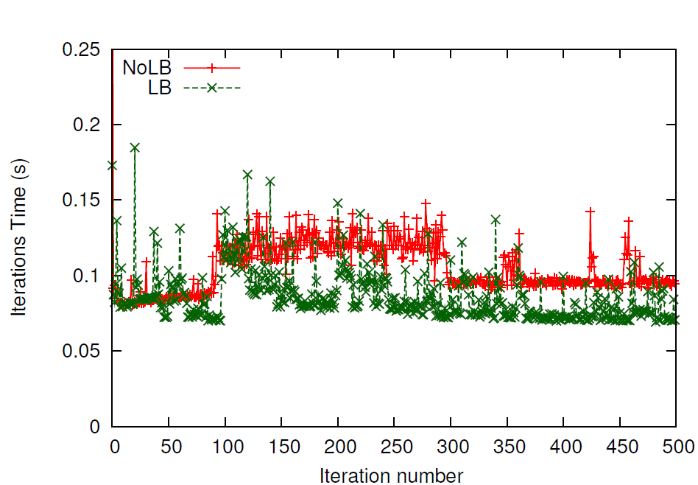
Results: Stencil3d
OpenStack on Open Cirrus test bed (3 types of processors), KVM, virtio-net, VMs: m1.small, vcpupin for pinning VCPU to physical cores
Sequential NPB-FT as interference, Interfering VM pinned to one of the cores that the VMs of our parallel runs use
Multi-tenancy
awareness
Low is better
Heterogeneity
awareness
Periodically measuring idle time and migrating load away from time-shared VMs works well in practice.
Notes:
To understand the effect of our load balancer under heterogeneity
and interference, we ran 500 iterations of Stencil2D
on 32 VMs (8 physical nodes – one Slow, rest Fast), and
plotted the iteration time (execution time of an iteration) vs.
iteration number in Figure 3. In this experiment, we started the
job in interfering VM after 100 iterations of parallel job had
completed. Load balancing was performed after every 20 steps,
which manifests itself as spikes in the iteration time every
20th step. We report execution times averaged across three
runs and use wall clock time, which includes the time taken
for object migration. The LB curve starts to show benefits
as we reach 100 iterations, due to heterogeneity-aware load
balancing. After 100 iterations, interfering job starts. When the
load balancer kicks in, it restores load balance by redistributing
tasks among VMs according to Algorithm 1. Now, there is a
large gap between the two curves demonstrating the benefits
of our refinement based approach, which takes around 3 load
balancing steps to gradually reduce the iteration time after
interference appears. The interfering job finishes at iteration
300 and hence the NoLB curve comes down. There is little
reduction in LB curve, since the previous load balancing steps
had reduced the impact of interference to a very small amount.
The difference between the two curves after that is due to
heterogeneity-awareness in load distribution.

Slide 38
Results: Improvements by LB
High is better
Heterogeneity and Interference – one Slow node, hence four Slow VMs, rest Fast, one interfering VM (on a Fast core) which starts at iteration 50.
Up to 40% benefits, evaluated till 64 cores. Larger scale?
A. Gupta, O. Sarood, L. Kale, and D. Milojicic, “Improving HPC Application Performance in Cloud through Dynamic Load Balancing,” at IEEE/ACM CCGRID ’13
Notes:
an interfering VM, we achieve up to 45% improvement in
500 iterations for Stencil2D and Wave2D and 200 iterations for
Mol3D, with load balancing every 20th step
execution time (Figure 6a).
The amount of benefits is different
for different applications, especially in Figure 6b. We studied
this behavior using Projections tool and found that our load
balancer is distributing tasks well for all applications, but the
difference in achieved benefits is due to the different sensitivity
of these applications to CPU type and frequency. It can be
inferred from Figure 6b that Mol3D is the most sensitive to
CPU frequency, having most scope for improvement. Next,
Figure 6c shows that our techniques are also effective in the
presence of both the effects – the inherent hardware heterogeneity
and the heterogeneity introduced by multi-tenancy.
Another observation from Figure 6 is the variation in the
achieved benefits with increasing number of VMs. This is
attributed to the tradeoff between two factors: (1) Since there
is only one VM sharing physical CPU with interfering VM,
running on larger number of VMs implies distributing the work
of the overloaded VM to an increasing number of underutilized
VMs, which results in larger reduction in execution time (e.g.
Figure 6a Mol3D, 8 VM vs. 16 VM). (2) As we scale, the
average compute load per VM decreases. Hence, other factors,
such as communication time, dominate the total execution
time. This implies that even with better load balance and
higher % reduction in compute time, overall benefit is small,
since communication time is unaffected. Hence, as we scale
further, benefits decrease, but they still remain substantial.
Moreover, as we scale, benefits can actually be more important
because we save across larger number of processors. As
an example, from Figure 6b Stencil2D, we save 18.8% over 32
VMs, with absolute savings = 32 0:188 48:09 = 289:28
CPU-seconds, where application took 48.09 seconds on 32
VMs. Juxtaposing this with 20.5% reduction in time over 16
VMs which results in absolute savings = 160:20586:77 =
284:32 CPU-seconds, where application took 86.77 seconds on
16 VMs, we see that the overall savings are more for 32 VM
case compared to 16 VMs. Also, since we achieve higher %
benefits with larger problem sizes (Section VI-A3, Figure 5c),
the benefits will be even higher for weak scaling compared to
strong scaling as the impact of factor 2 above is minimized.

Slide 39
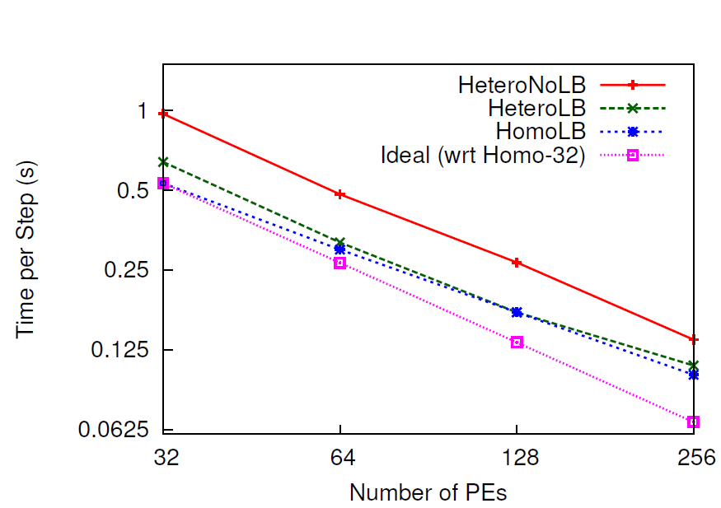
Scalability Results on Distem Cloud
LeanMD
Low is better
Good scaling with runtime-triggered MetaLB approach, MetaLB: Adaptive with low load balancing overhead

Slide 40
Outline
Performance analysis
HPC cloud divide
Bridging the gap between HPC and cloud
HPC-aware clouds
Application-aware cloud scheduler and VM consolidation
Cloud-aware HPC
Dynamic load balancing: improve HPC performance
Parallel runtime for malleable jobs: improve utilization
Models, cost analysis and multiple platforms in cloud
Lessons, conclusions, impact, and future work
Notes:
Increase resource util ➔ cost savings
They appear to be conflicting but as we will see, we can actually do good on both
Cloud offerings use application-agnostic VM placement
Poor performance of HPC apps in Cloud
Cost savings potential through application aware consolidation

Slide 41
Malleable Parallel Jobs
Dynamic shrink/expand number of processors
Twofold merit in the context of cloud computing.
Cloud provider perspective
Better system utilization, response time, and throughput
Honor job priorities
Cloud user perspective:
Dynamic pricing offered by cloud providers, such as Amazon EC2
Better value for the money spent based on priorities and deadlines
Applicable beyond clouds
Malleable jobs have tremendous but unrealized potential,
What do we need to enable malleable HPC jobs?
Notes:
dynamic expand/shrink capability of a job is invaluable in case of dynamic pricing offered by cloud providers, such as Amazon EC2 spot pricing which is based on variable market demands and supply. Such adaptivity gives the user additional ﬂexibility and helps him in obtaining better value for the money spent based on his priorities and deadlines.
Secondly, from the cloud provider’s perspective, adaptive jobs along with a smart scheduler are pivotal to attain better system utilization, response time, and throughput while following Quality of Service (QoS) agreements such as ﬁxed execution time for the agreed budget

Slide 42
Components of a Malleable Jobs System
New Jobs
Cluster
Nodes
Launch
Monitor
Shrink
Expand
Job Queue
Node Scheduler
Decisions
Scheduling Policy Engine
Execution Engine
Cluster State Changes
Shrink Ack.
Expand Ack.
Adaptive
Job Scheduler
Adaptive
Resource Manager
Adaptive/Malleable Parallel Runtime System
We will focus on Malleable Parallel Runtime

Slide 43
Malleable RTS Summary
Object migration, checkpoint-restart, Linux shared memory, load balancing, implemented atop Charm++
Adapts load distribution well on rescale (Efficient)
2k->1k in 13s, 1k->2k in 40s (Fast)
Scales well with core count and problem size (Scalable)
Little application programmer effort (Low-effort)
4 mini-applications: Stencil2D, LeanMD, Wave2D, Lulesh
15-37 SLOC, For Lulesh, 0.4% of original SLOC
Can be used in most systems (Practical)
What are the benefits for HPC in cloud?
A. Gupta, B. Acun, O. Sarood, and L. Kale “Towards Realizing the Potential of Malleable Parallel Jobs,” IEEE HiPC ’14
Notes:
Downloaded SLURM code and doing preliminary investigation. In SLURM, job launch can be done by SLURM (using srun), or by application (e.g. we can use charmrun). Job allocation, that is assignment of nodes to a job request, is separate from job launch. SLURM has a manager daemon and a slurmd daemon on each compute node. slurmd daemons are used by srun. We can decide if we want to use srun or not. I recommend we can stick with charmrun for now. For shrink/expand, we can add commands like sexpand, sshrink or srealloc analogous to existing SLURM commands (e.g. salloc). srealloc would: 1. Do the SLURM pre-processing that happens with salloc (e.g database update) 2. Communicate with the application using CCS 3. Wait (block?) for some time or expect a response from aplication 4. Dp SLURM post-processing e.g that happens when a job exits, here part of nodes are reusable in case of shrink. Besides this, we will need to add new scheduling algorithms, I think that can be added as a plugin. A link to SLURM quickstart: https://computing.llnl.gov/linux/slurm/quickstart.html

Slide 44
Applicability to HPC in Cloud
Provider perspective
Improve utilization: malleable jobs + adaptive job scheduling
Stampede interactive mode as cluster for demonstration
User Perspective
Price-sensitive rescale in spot markets
Notes:
Downloaded SLURM code and doing preliminary investigation. In SLURM, job launch can be done by SLURM (using srun), or by application (e.g. we can use charmrun). Job allocation, that is assignment of nodes to a job request, is separate from job launch. SLURM has a manager daemon and a slurmd daemon on each compute node. slurmd daemons are used by srun. We can decide if we want to use srun or not. I recommend we can stick with charmrun for now. For shrink/expand, we can add commands like sexpand, sshrink or srealloc analogous to existing SLURM commands (e.g. salloc). srealloc would: 1. Do the SLURM pre-processing that happens with salloc (e.g database update) 2. Communicate with the application using CCS 3. Wait (block?) for some time or expect a response from aplication 4. Dp SLURM post-processing e.g that happens when a job exits, here part of nodes are reusable in case of shrink. Besides this, we will need to add new scheduling algorithms, I think that can be added as a plugin. A link to SLURM quickstart: https://computing.llnl.gov/linux/slurm/quickstart.html

Slide 45
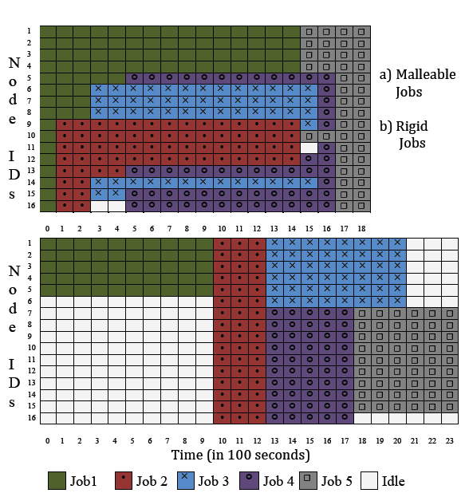
Provider Perspective: Case Study
Job 1 shrinks
Reduced response time
Job 5 expands
Improved utilization
Malleable
Cluster State
Reduced makespan
Rigid
5 jobs
Stencil2D, 1000 iterations each
4-16 nodes, 16 cores per node
16 nodes total in cluster
Dynamic Equipartitioning for malleable jobs
FCFS for rigid jobs
Idle nodes
Time
Notes:
Downloaded SLURM code and doing preliminary investigation. In SLURM, job launch can be done by SLURM (using srun), or by application (e.g. we can use charmrun). Job allocation, that is assignment of nodes to a job request, is separate from job launch. SLURM has a manager daemon and a slurmd daemon on each compute node. slurmd daemons are used by srun. We can decide if we want to use srun or not. I recommend we can stick with charmrun for now. For shrink/expand, we can add commands like sexpand, sshrink or srealloc analogous to existing SLURM commands (e.g. salloc). srealloc would: 1. Do the SLURM pre-processing that happens with salloc (e.g database update) 2. Communicate with the application using CCS 3. Wait (block?) for some time or expect a response from aplication 4. Dp SLURM post-processing e.g that happens when a job exits, here part of nodes are reusable in case of shrink. Besides this, we will need to add new scheduling algorithms, I think that can be added as a plugin. A link to SLURM quickstart: https://computing.llnl.gov/linux/slurm/quickstart.html

Slide 46
User Perspective: Price-sensitive Rescale in Spot Markets
Spot markets
Bidding based
Dynamic price
Set high bid to avoid termination (e.g. $1.25)
Pay whatever the spot price or no progress
Can I control the price I pay, and still make progress?
Amazon EC2 spot price variation: cc2.8xlarge instance Jan 7, 2013
Our solution: keep two pools
Static: certain minimum number of reserved instances
Dynamic: price-sensitive rescale over the spot instance pool
Expand when the spot price falls below a threshold
Shrink when it exceeds the threshold.
Notes:
Amazon offers 2 types of VM instances – reserved/on-demand and spot
Spot instances offer the unused cloud capacity at a dynamically varying
price, typically very small compared to on-demand instance price.
Spot instances work on a
bidding based model. A users places her bid for compute power. If and when her bid exceeds
the current spot price, instances are allocated to the user. When the spot price exceeds the
bid, the instances are terminated without notice. The user is charged with the spot price
at the start of each instance-hour.
The spot price changes periodically based on supply and
demand.

Slide 47
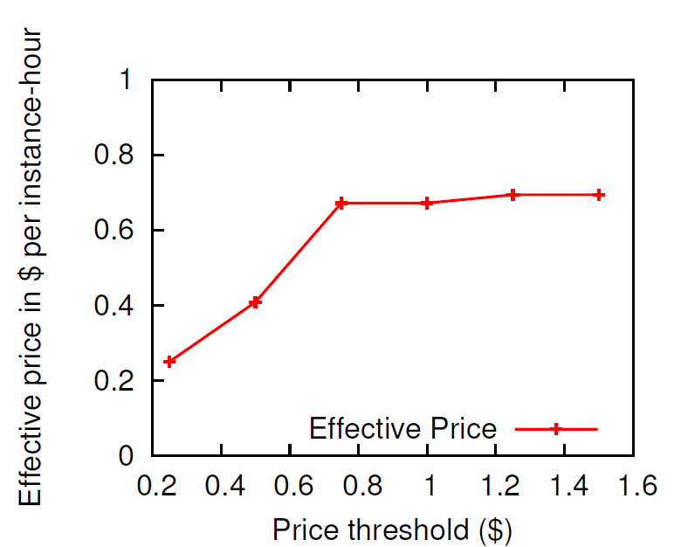
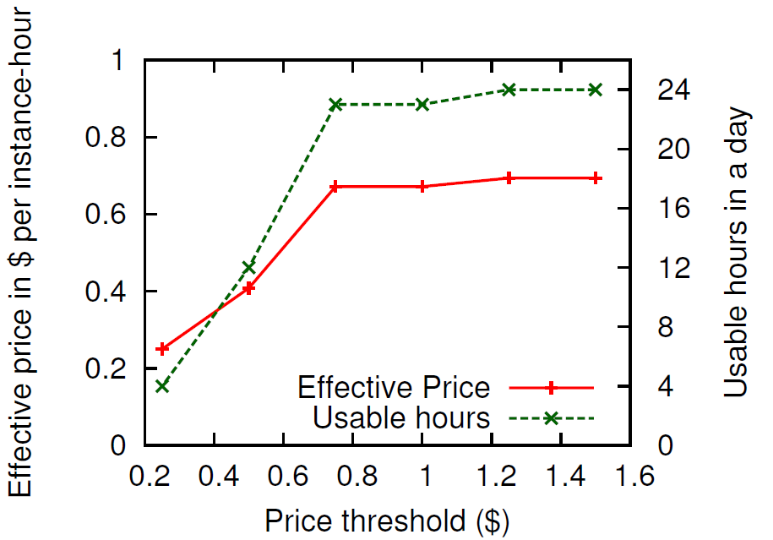
User Perspective: Price-sensitive Rescale in Spot Markets
Price Calculation
No rescale: $16.65 for 24 hours
With rescale: freedom to select price threshold
Usable hours may be reduced
Dynamic shrinking and expansion of HPC jobs can enable lower effective price in cloud spot markets
Notes:
Downloaded SLURM code and doing preliminary investigation. In SLURM, job launch can be done by SLURM (using srun), or by application (e.g. we can use charmrun). Job allocation, that is assignment of nodes to a job request, is separate from job launch. SLURM has a manager daemon and a slurmd daemon on each compute node. slurmd daemons are used by srun. We can decide if we want to use srun or not. I recommend we can stick with charmrun for now. For shrink/expand, we can add commands like sexpand, sshrink or srealloc analogous to existing SLURM commands (e.g. salloc). srealloc would: 1. Do the SLURM pre-processing that happens with salloc (e.g database update) 2. Communicate with the application using CCS 3. Wait (block?) for some time or expect a response from aplication 4. Dp SLURM post-processing e.g that happens when a job exits, here part of nodes are reusable in case of shrink. Besides this, we will need to add new scheduling algorithms, I think that can be added as a plugin. A link to SLURM quickstart: https://computing.llnl.gov/linux/slurm/quickstart.html

Slide 48
Outline
Performance analysis
HPC cloud divide
Bridging the gap between HPC and cloud
HPC-aware clouds
Application-aware cloud scheduler and VM consolidation
Cloud-aware HPC
Dynamic load balancing: improve HPC performance
Parallel runtime for malleable jobs: improve utilization
Models, cost analysis and multiple platforms in cloud
Lessons, conclusions, impact, and future work
Notes:
So far we discussed the perf evaluation results and some techniques for bridging the gap.. Does that mean we can use a model for hpc in clpud where sc can be substituted by clouds?
Increase resource util ➔ cost savings
They appear to be conflicting but as we will see, we can actually do good on both
Cloud offerings use application-agnostic VM placement
Poor performance of HPC apps in Cloud
Cost savings potential through application aware consolidation

Slide 49
Models for HPC in Cloud
Cloud as substitute for supercomputers for all HPC applications? (Past work)
Supercomputers defeat cloud in raw performance
Some HPC applications just do not scale in cloud
Cloud complement supercomputers? (Our position)
User perspective
Lower cost of running in cloud vs. supercomputer?
For some applications?
Provider perspective
Hybrid cloud supercomputer approach
Use underutilized resource “good enough” for a job
Reduce wait time and improve throughput
Notes:
To justify our position and evaluate the benefits.. We present both perspectives..

Slide 50
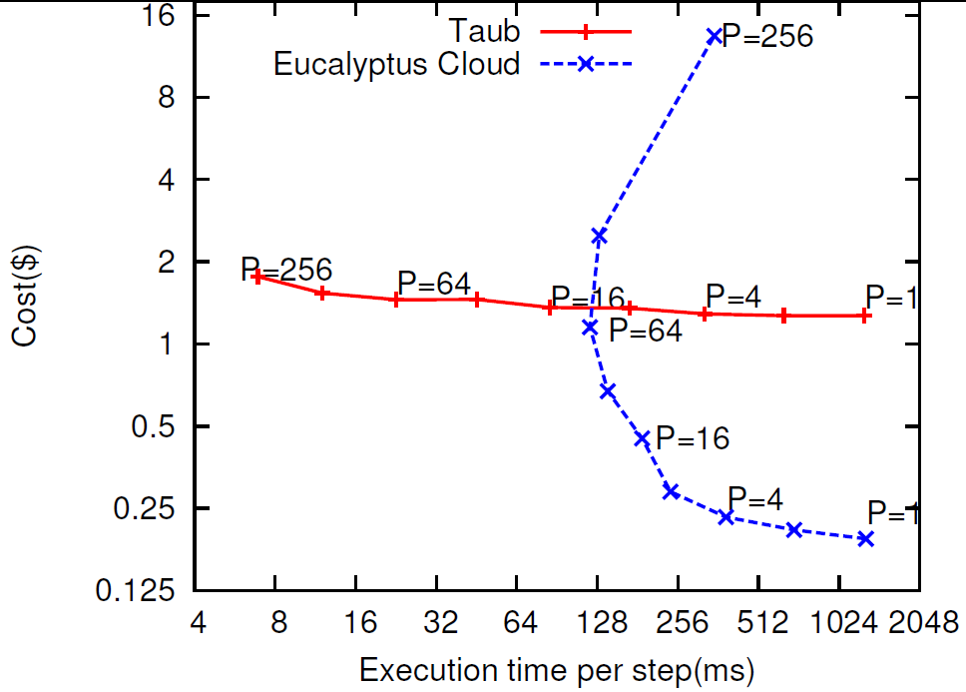
User Perspective: HPC-Cloud Economics
Cost = instance price ($ per core-hour) × P × Time
NAMD Scaling Right to left
Time constraint
Choose this
Low is better
Cost constraint
Choose this
Low is better
Interesting cross-over points when considering cost. Best platform depends on scale, budget.
Notes:
Application to app
scale

Slide 51
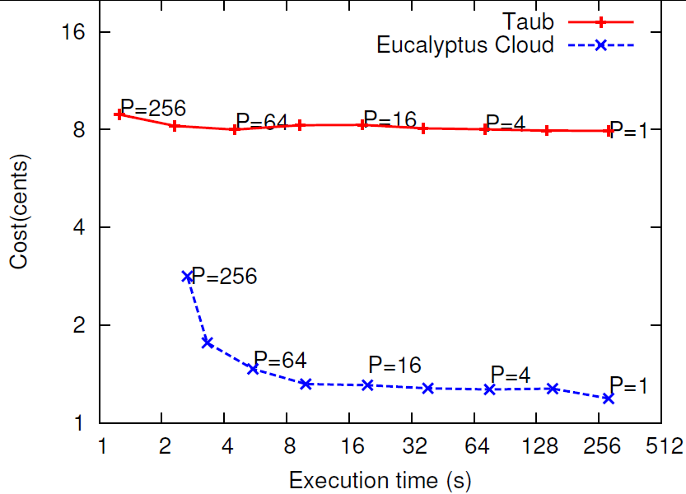
User Perspective: HPC-Cloud Economics
Cost = Charging rate($ per core-hour) × P × Time
Low is better
Best platform depends on application characteristics.
Automated platform selection simulation: up to 60% cost reduction at 10-15% performance penalty
A. Gupta et al., “Exploring the Performance and Mapping of HPC Applications to Platforms in the cloud,” short paper in HPDC ’12. New York, NY, USA: ACM, 2012
Notes:
We will come back to this point in proposed work section.

Slide 52
Provider Perspective: Multi-Platform Approach
Job Ji = (t,p), t_{n}= f(n,p), n∈N platforms
Mapping jobs to platforms
Can clouds complement supercomputer? Is it a feasible model?
How to map jobs? Use Heuristics
Notes:
App charact for complex hpc apps is extremely challenging problem.. In this thesis, we focus on the mapping issues.. That is you have some benchmarking data..

Slide 53
Static Application-Aware Heuristics
Scale
(number of cores)
Red: Slowdown
Light blue: No slowdown
Scale
(number of cores)
Notes:
For AppPartition –
Take avg slowdown along vertical dimension.. Sort cloud vs sc.. Assign lowest according to equi-partition
Then cluster vs sc and assign lowest according to equip
For scalePartition.. Equipart..
Diagonal heurstic…

Slide 54
Static Application-Aware Heuristics
Red: Slowdown
Light blue: No slowdown
AppPartition
Cluster
Cloud
Supercomputer
Notes:
Downloaded SLURM code and doing preliminary investigation. In SLURM, job launch can be done by SLURM (using srun), or by application (e.g. we can use charmrun). Job allocation, that is assignment of nodes to a job request, is separate from job launch. SLURM has a manager daemon and a slurmd daemon on each compute node. slurmd daemons are used by srun. We can decide if we want to use srun or not. I recommend we can stick with charmrun for now. For shrink/expand, we can add commands like sexpand, sshrink or srealloc analogous to existing SLURM commands (e.g. salloc). srealloc would: 1. Do the SLURM pre-processing that happens with salloc (e.g database update) 2. Communicate with the application using CCS 3. Wait (block?) for some time or expect a response from aplication 4. Dp SLURM post-processing e.g that happens when a job exits, here part of nodes are reusable in case of shrink. Besides this, we will need to add new scheduling algorithms, I think that can be added as a plugin. A link to SLURM quickstart: https://computing.llnl.gov/linux/slurm/quickstart.html

Slide 55
Static Application-Aware Heuristics
Red: slowdown
Light blue: No slowdown
ScalePartition
Supercomputer
Cluster
Cloud
Notes:
Downloaded SLURM code and doing preliminary investigation. In SLURM, job launch can be done by SLURM (using srun), or by application (e.g. we can use charmrun). Job allocation, that is assignment of nodes to a job request, is separate from job launch. SLURM has a manager daemon and a slurmd daemon on each compute node. slurmd daemons are used by srun. We can decide if we want to use srun or not. I recommend we can stick with charmrun for now. For shrink/expand, we can add commands like sexpand, sshrink or srealloc analogous to existing SLURM commands (e.g. salloc). srealloc would: 1. Do the SLURM pre-processing that happens with salloc (e.g database update) 2. Communicate with the application using CCS 3. Wait (block?) for some time or expect a response from aplication 4. Dp SLURM post-processing e.g that happens when a job exits, here part of nodes are reusable in case of shrink. Besides this, we will need to add new scheduling algorithms, I think that can be added as a plugin. A link to SLURM quickstart: https://computing.llnl.gov/linux/slurm/quickstart.html

Slide 56
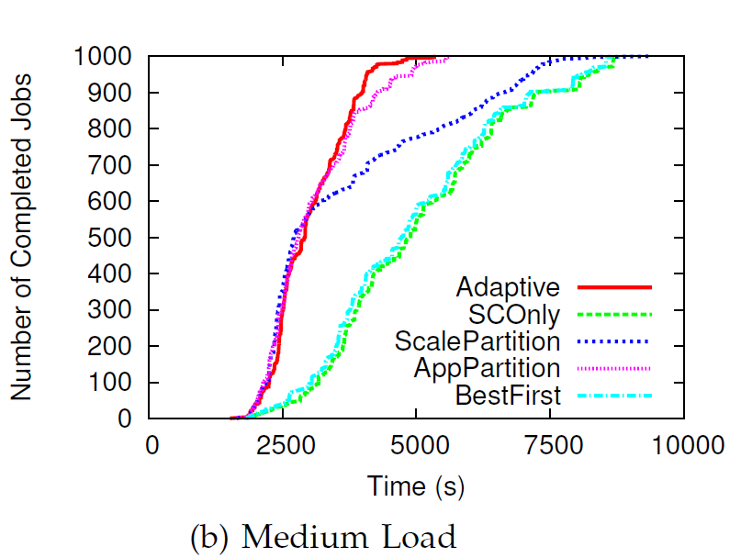
Multi-platform Mapping Benefits
CloudSim: 3 datacenters – supercomputer, cluster, cloud (256 cores each)
Job logs from Parallel Workload Archive, first 1000 jobs
Each job record: (job’s arrival time, number of cores (P), runtime on supercomputer, application name assigned randomly)
Steeper is better
Normal load
High load: runtimes scaled up by 2X.
Significant improvement in throughput (6X) and makespan (1.8X), attributed to improved response time and runtime
A. Gupta et al., “Evaluating and Improving the Performance and Mapping of HPC in Cloud,” IEEE TCC Special issue.
Notes:
Downloaded SLURM code and doing preliminary investigation. In SLURM, job launch can be done by SLURM (using srun), or by application (e.g. we can use charmrun). Job allocation, that is assignment of nodes to a job request, is separate from job launch. SLURM has a manager daemon and a slurmd daemon on each compute node. slurmd daemons are used by srun. We can decide if we want to use srun or not. I recommend we can stick with charmrun for now. For shrink/expand, we can add commands like sexpand, sshrink or srealloc analogous to existing SLURM commands (e.g. salloc). srealloc would: 1. Do the SLURM pre-processing that happens with salloc (e.g database update) 2. Communicate with the application using CCS 3. Wait (block?) for some time or expect a response from aplication 4. Dp SLURM post-processing e.g that happens when a job exits, here part of nodes are reusable in case of shrink. Besides this, we will need to add new scheduling algorithms, I think that can be added as a plugin. A link to SLURM quickstart: https://computing.llnl.gov/linux/slurm/quickstart.html

Slide 57
Key Takeaways
Evaluation and Mapping
Lightweight virtualization necessary to remove overheads
Characterization for complex applications non-trivial but economic benefits are substantial (e.g. multi-platforms)
HPC-aware clouds
Although counterintuitive, HPC users and cloud providers can achieve win-win by consolidating VMs using smart co-locations
Cloud schedulers need knowledge of application characteristics
Cache, communication, HPC vs. non-HPC
Cloud-aware HPC
Heterogeneity and multi-tenancy challenge for HPC
Dynamic environment in clouds necessitate adaptive HPC RTS
57

Slide 58
Conclusions (1)
Computationally intensive applications
Public Clouds
HPC in current clouds is suitable for some but not all applications – needs characterization and mapping
Notes:
High Performance Computing (HPC) refers to the practice of aggregating computing power
to deliver much higher performance than typical desktop/laptop computers with the goals
of solving computationally intensive applications in science, engineering, or business. HPC
has traditionally been restricted to a niche segment comprising scientists who use super-
computers at national laboratories to enhance human knowledge by understanding how the
universe works. They use the tremendous computational power to understand how scientic
phenomena operate and evolve in scientic elds such as cosmology, molecular dynamics,
quantum chemistry, climate, and human genetics. More recently, HPC is also being used in
industry for business and analytics. According to November 2013 top500 list, 56.4% of top
500 supercomputing systems are used by industry

Slide 59
Conclusions (2)
Public Clouds
Feasible to bridge the gap between HPC and cloud – HPC-aware clouds and cloud-aware HPC
Notes:
High Performance Computing (HPC) refers to the practice of aggregating computing power
to deliver much higher performance than typical desktop/laptop computers with the goals
of solving computationally intensive applications in science, engineering, or business. HPC
has traditionally been restricted to a niche segment comprising scientists who use super-
computers at national laboratories to enhance human knowledge by understanding how the
universe works. They use the tremendous computational power to understand how scientic
phenomena operate and evolve in scientic elds such as cosmology, molecular dynamics,
quantum chemistry, climate, and human genetics. More recently, HPC is also being used in
industry for business and analytics. According to November 2013 top500 list, 56.4% of top
500 supercomputing systems are used by industry

Slide 60
Conclusions
HPC in current clouds is suitable for some but not all applications and can be made more efficient using intelligent mapping of applications to platforms, HPC-aware cloud scheduling, and cloud-aware HPC execution.
HPC in the cloud for some applications not all
Application characteristics and scale, performance-cost tradeoffs
Intelligent mapping of applications to platforms
Bridge the gap between HPC and cloud
HPC-aware cloud scheduling
Application-aware scheduling
Characterization and interference-aware consolidation
Cloud-aware HPC execution
Heterogeneity and Multi-tenancy aware load balancing
Malleable jobs
Challenges and opportunities, cloud provider vs. cloud user
60
Notes:
Goal of increasing the utilization of underutilized resources through
The high-level question I wanted to answer in this talk is, can we build a large-scale update-intensive Internet service using and make it cheap, fast, manageable, available at the same time. And I think I answered the question affirmatively. The key insight I used to answer this question is the exploitation of A. S. For example, ….. By using application-specific requirements, we can achieve goals that are often contradicting, such as in cheapness and availability.
A system for cloud providers..
A system for HPC-cloud users..
Many ideas applicaton to exascale RTS..

Slide 61
Open Problems and Directions
Linux containers, Docker for packaging HPC applications
Multi-platforms, mapping, and models
Application characterization
HPC-as-a-Service and multi-level cloud scheduling system
Supercomputer using a cloud model
HPC-aware clouds
Interaction between application and resource manager
Job interference categorization
Security for HPC in cloud
Cloud-aware HPC
Communication optimizations in HPC runtime
Adaptive communication-aware load balancing
61
Notes:
Goal of increasing the utilization of underutilized resources through
The high-level question I wanted to answer in this talk is, can we build a large-scale update-intensive Internet service using and make it cheap, fast, manageable, available at the same time. And I think I answered the question affirmatively. The key insight I used to answer this question is the exploitation of A. S. For example, ….. By using application-specific requirements, we can achieve goals that are often contradicting, such as in cheapness and availability.
A system for cloud providers..
A system for HPC-cloud users..
Many ideas applicaton to exascale RTS..

Slide 62
Resources
Amazon EC2, Microsoft Azure, Grid 5000, …
Docker, Openstack
MPI, Charm++
http://charm.cs.uiuc.edu/research/cloud
gupta59@Illinois.edu , LinkedIn
62
Notes:
Goal of increasing the utilization of underutilized resources through
The high-level question I wanted to answer in this talk is, can we build a large-scale update-intensive Internet service using and make it cheap, fast, manageable, available at the same time. And I think I answered the question affirmatively. The key insight I used to answer this question is the exploitation of A. S. For example, ….. By using application-specific requirements, we can achieve goals that are often contradicting, such as in cheapness and availability.
A system for cloud providers..
A system for HPC-cloud users..
Many ideas applicaton to exascale RTS..

Slide 63
Thanks
VTDC Organizers
Dr. Laxmikant V. Kale, UIUC
Dr. Dejan Milojicic, HP Labs.
63
Notes:
Goal of increasing the utilization of underutilized resources through
The high-level question I wanted to answer in this talk is, can we build a large-scale update-intensive Internet service using and make it cheap, fast, manageable, available at the same time. And I think I answered the question affirmatively. The key insight I used to answer this question is the exploitation of A. S. For example, ….. By using application-specific requirements, we can achieve goals that are often contradicting, such as in cheapness and availability.
A system for cloud providers..
A system for HPC-cloud users..
Many ideas applicaton to exascale RTS..

Slide 64
References
A. Gupta et al., “Evaluating and Improving the Performance and Mapping of HPC in Cloud,” IEEE TCC Special issue
A. Gupta et al., “The Who, What, Why and How of High Performance Computing Applications in the Cloud,” Best paper at IEEE CloudCom 2013
A. Gupta, O. Sarood, L. Kale, and D. Milojicic, “Improving HPC Application Performance in Cloud through Dynamic Load Balancing,” accepted at IEEE/ACM CCGRID ’13
A. Gupta, L. Kale, D. Milojicic, P. Faraboschi, and S. Balle, “HPC-Aware VM Placement in Infrastructure Clouds ,” at IEEE Intl. Conf. on Cloud Engineering IC2E ’13
A. Gupta et al., “Exploring the Performance and Mapping of HPC Applications to Platforms in the cloud,” short paper in HPDC ’12. New York, NY, USA: ACM, 2012
A. Gupta et al., “Realizing the Potential of Malleable Parallel Jobs,” HiPC 2014
A. Gupta and D. Milojicic, “Evaluation of HPC Applications on Cloud,” in Open Cirrus Summit Best Student Paper, Atlanta, GA, Oct. 2011
A. Gupta, D. Milojicic, and L. Kale, “Optimizing VM Placement for HPC in Cloud,” in Workshop on Cloud Services, Federation and the 8th Open Cirrus Summit, San Jose, CA, 2012
A. Gupta and L. V. Kale, “Towards Efficient Mapping, Scheduling, and Execution of HPC Applications on Platforms in Cloud,” short paper and poster at 27th International Parallel and Distributed Processing Symposium(IPDPS) Ph.D Forum’13 Best PhD Forum award
O. Sarood, A. Gupta, and L. V. Kale, “Cloud Friendly Load Balancing for HPC Applications: Preliminary Work,” in 41st Intl. Conf. on Parallel Processing Workshops (ICPPW), 2012

