Slide 1
A uGNI-Based Asynchronous Message-driven Runtime System for Cray Supercomputers with Gemini Interconnect
26th IEEE International Parallel & Distributed Processing Symposium
Yanhua Sun, Gengbin Zheng, Laximant(Sanjay) Kale
Parallel Programming Lab
University of Illinois at Urbana-Champaign
Ryan Olson, Cray Inc
Terry R. Jones, Oak Ridge National Lab

Slide 2
Motivation
Modern interconnects are complex
Multiple programming models/languages are developed

Slide 3
Motivation
Modern interconnects are complex
Multiple programming models/languages are developed
How to attain good performance for applications in alternative models on different interconnects ?

Slide 4
Motivation
Modern interconnects are complex
Multiple programming models/languages are developed
How to attain good performance for applications in alternative models on different interconnects ?
Charm++ programming model on Gemini Interconnect
Notes:
For example NQueens

Slide 5
Outline
Overview of Charm++, Gemini and uGNI
Design of uGNI-based Charm++
Optimizations to improve communication
Micro-benchmark and application results

Slide 6
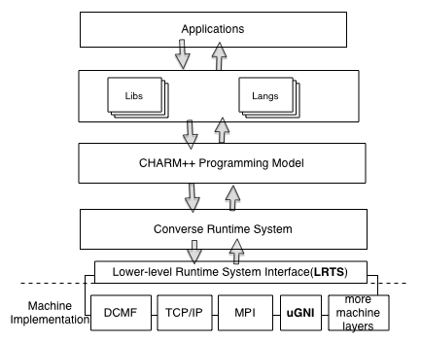
Charm++ Software Architecture
Charm++ is an
object-based over decomposition programming model
Adaptive intelligent runtime
dynamic load balancing
fault tolerance
Scales to 300K cores
Portable
Run on MPI

Slide 7
Gemini Interconnect
Low latency (700ns)
High bandwidth (8GBytes/sec)
Scale to 100,000 nodes
Notes:
Framework . User do not need to know any of these problems and techniques

Slide 8
Gemini Interconnect
Low latency (700ns)
High bandwidth (8GBytes/sec)
Scale to 100,000 nodes
Hardware support for one-sided communication
Fast Memory Access (FMA)
Block Transfer Engine (BTE)
Notes:
Framework . User do not need to know any of these problems and techniques

Slide 9
uGNI
User-level Generic Network Interface
Memory Registration/de-
Post FMA/BTE transactions
Completion Queues

Slide 10
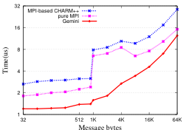
Initial Pingpong Performance
Notes:
Unnecessary features in MPI lead to overhead
Data interaction pattern in Charm++ is different from MP : Only sender-involving

Slide 11
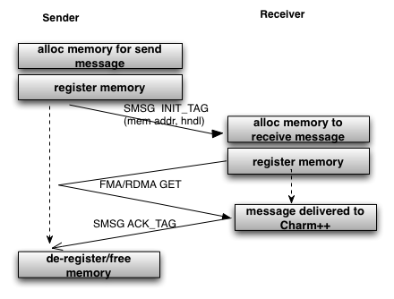
Design of uGNI-based Charm++
Small messages (less than 1024 bytes)
SMSG directly send with data_tag

Slide 12
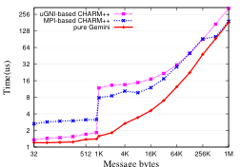
Baseline Pingpong Performance

Slide 13
Persistent Messages
Communication with fixed pattern
Communication processors
Data size
Re-use memory
Avoid memory allocation
Avoid the first handshake message

Slide 14
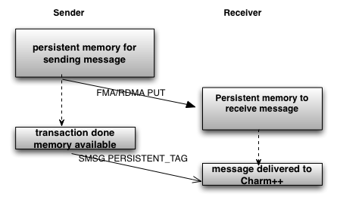
Persistent Messages
Baseline design to transfer data
Transfer persistent messages

Slide 15
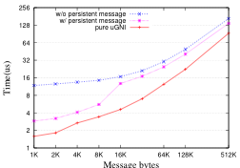
Persistent Messages Performance

Slide 16
Memory Pool
Memory registration/de-registration costs a lot
Charm++ controls all memory allocation/de-allocation

Slide 17
Memory Pool
Memory registration/de-registration costs a lot
Charm++ controls all memory allocation/de-allocation
Pre-alloc/register big chucks of memory
Allocation/de- is from memory pool

Slide 18
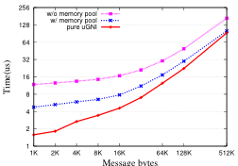
Performance of Memory Pool

Slide 19
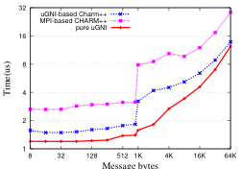
Performance – Message Latency

Slide 20
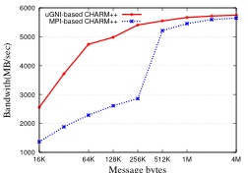
Performance - Bandwidth

Slide 21
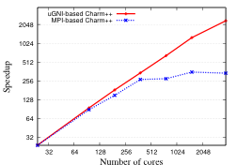
NQueens (fine-grained)

Slide 22
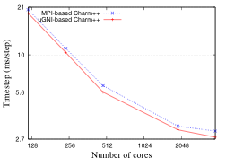
NAMD Performance

Slide 23
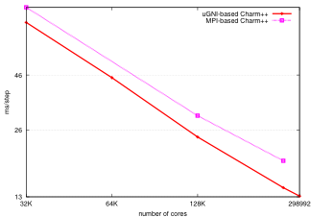
NAMD 100M-atom on Titan
17%
32%
70% efficiency

Slide 24
Conclusion
Gemini Interconnect, Charm++
Optimizations
Persistent messages
Memory pool
Micro-benchmark and application results
http://charm.cs.uiuc.edu/software

