Slide 1
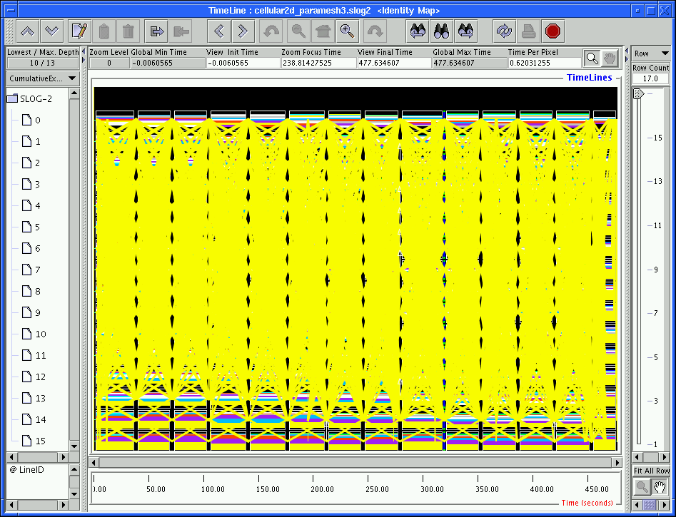
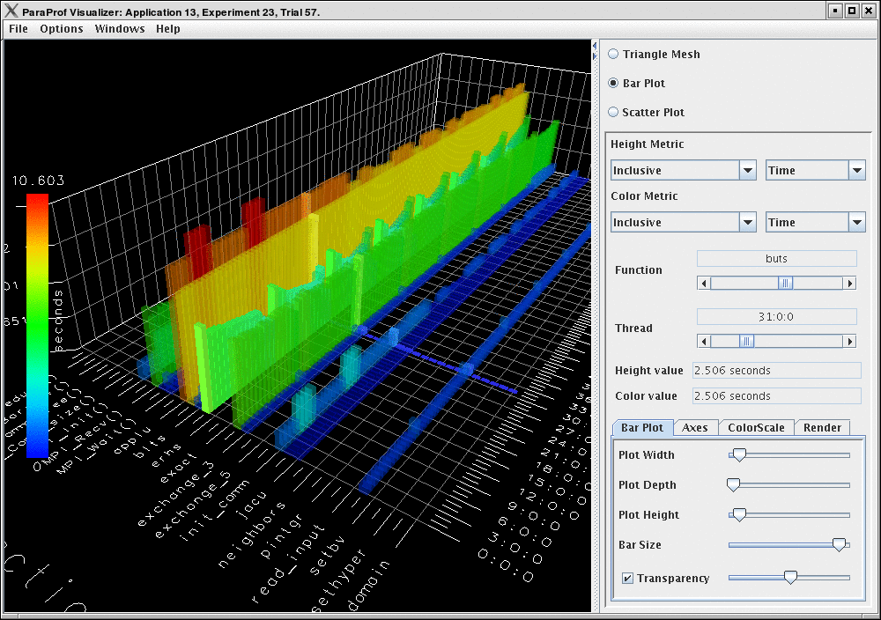
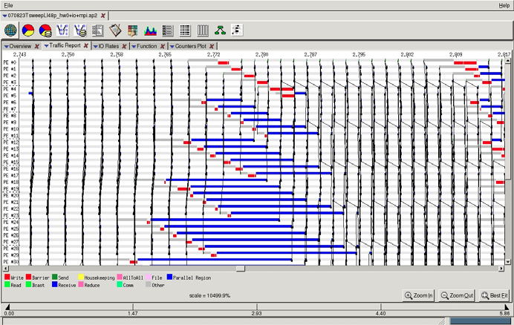
Techniques in Scalable and Effective Performance Analysis
Thesis Defense - 11/10/2009
By Chee Wai Lee
Notes:
Thank Attendees and Committee.
The thesis – investigate and develop techniques to enhance effectiveness of performance analysis process for applications scaled to large numbers of processors.
Lead-out: In this presentation, I will …

Slide 2
Overview
Introduction.
Scalable Techniques:
Support for Analysis Idioms
Data Reduction
Live Streaming
Hypothesis Testing
Conclusion.
Notes:
…
Briefly introduce the problem. What aspects of analysis are affected by application scaling?
I will then discuss the techniques developed over the 4 main thrusts to address problems.
Finally, will conclude with a summary of thesis contributions.

Slide 3
Introduction
What does performance analysis of applications with visual tools entail?
What are the effects of application scaling on performance analysis?
Notes:
So, what do we do when analyzing applications for performance problems?

Slide 4
Effects of Application Scaling
Enlarged performance-space.
Increased performance data volume.
Reduces accessibility to machines and increases resource costs
Time to queue.
CPU resource consumption.
Notes:
Analysts have to scan over a wider performance-space.
Very large datasets are cumbersome and hard to load.
Need to submit wider instrumented runs for analysis.
Problems call out for solutions …

Slide 5
Main Thrusts
Tool feature support for Scalable Analysis Idioms.
Online reduction of performance data volume.
Analysis Idioms for applications through live performance streaming.
Effective repeated performance hypothesis testing through simulation.
Notes:
… that drive the 4 main thrusts of research in this thesis.
Examine Techniques to handle enlarged performance space by making sure idioms use features that do not breakdown …
Then, look at what to do with data so large that it is cumbersome. We want techniques that reduce data volume while keeping reduced datasets relevant for finding problems.
We also look at scenarios where we can avoid recording a large volume of data by streaming it live to an remote client and the analysis idioms enabled.
Finally, we look at how techniques using trace-based simulation can make repeated hypothesis testing more feasible at large scales.

Slide 6
Main Thrusts
Tool feature support for Scalable Analysis Idioms.
Online reduction of performance data volume.
Analysis Idioms for applications through live performance streaming.
Effective repeated performance hypothesis testing through simulation.
Notes:
Let us first look at the techniques in the first thrust of this thesis.

Slide 7
Scalable Tool Features: Motivations
Performance analysis idioms need to be effectively supported by tool features.
Idioms must avoid using tool features that become ineffectual at large processor counts.
We want to catalog common idioms and match these with scalable features.
Notes:
First, we look at some motivations.
We observe that … Performance analysis idioms …

Slide 8
Scalable Tool Feature Support (1/2)
Non-scalable tool features require analysts to scan for visual cues over the processor domain.
How do we avoid this requirement on analysts?

Slide 9
Scalable Tool Feature Support (2/2)
Aggregation across processor domain:
Histograms.
High resolution Time Profiles.
Processor selection:
Extrema Tool.
Notes:
There are two basic approaches:
Aggregate to produce features that can aid the identification of visual cues.
Or for idioms that require specific timelines of processors to be examined. There would be a need to narrow the field to a manageable set of candidate processors.

Slide 10
Histogram as a Scalable Tool Feature
Bins represent time spent by activities.
Counts of activities across all processors are added to appropriate bins.
Total counts for each activity are displayed as different colored bars.

Slide 11
Case Study:
Apparent load imbalance.
No strategy appeared to solve imbalance.
Picked overloaded processor timelines.*
Found longer-than-expected activities.
Longer activities associated with specific objects.
Possible work grainsize distribution problems.
*As we will see later, not effective with large numbers of processors.

Slide 12
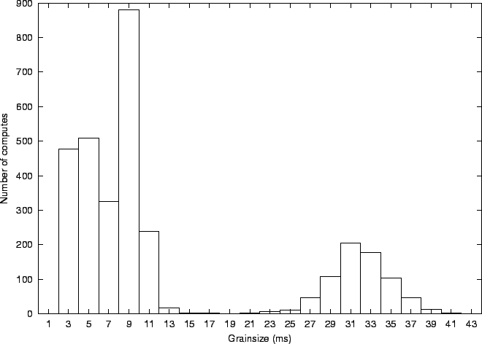
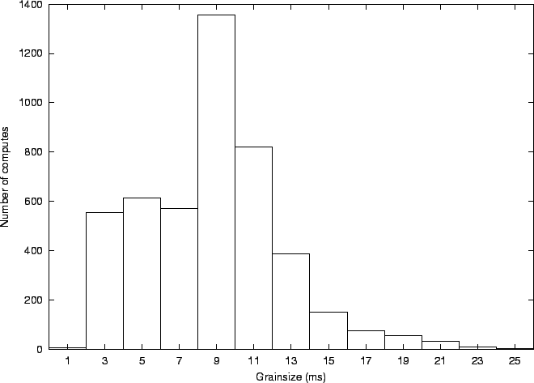
Case Study: Validation using Histograms

Slide 13
Effectiveness of Idiom
Need to find way to pick out overloaded processors. Not scalable!
Finding out if work grainsize was a problem simply required the histogram feature.
Notes:
One might be tempted to consider the previous sequence of performance analysis steps as a suitable idiom for discovering grainsize distribution problems.
But the step which requires the analyst to pick out the most overloaded processors is not scalable!
In fact, Histograms become the direct feature to use for the idioms for finding out if an application had grainsize distribution problems.

Slide 14
High Resolution Time Profiles
Shows activity-overlap over time summed across all processors.
Heuristics guide the search for visual cues for various potential problems:
Gradual downward slopes hint at possible load imbalance.
Gradual upward slopes hint at communication inefficiencies.
At high resolution, gives insight into application sub-structure.
Notes:
What about the usefulness of the other aggregated approach to scalable visual analysis?
On the other screen, you can see one such time profile.

Slide 15
Case Study: Using Time Profiles
Bigger!
Possible Load Imbalance
After Greedy Load Balancing Strategy
Notes:
Speed this up! 4:14 is way too long!

Slide 16
Finding Extreme or Unusual Processors
A recurring theme in analysis idioms.
Easy to pick out timelines in datasets with small numbers of processors.
Examples of attributes and criteria:
Least idle processors.
Processors with late events.
Processors that behave very differently from the rest.
Notes:
In this case, we want to look at the candidates with the least-idle times.

Slide 17
The Extrema Tool
Semi-automatically picks out interesting processors to display.
Decisions based on analyst-specified criteria.
Mouse-clicks on bars load interesting processors onto timeline.

Slide 18
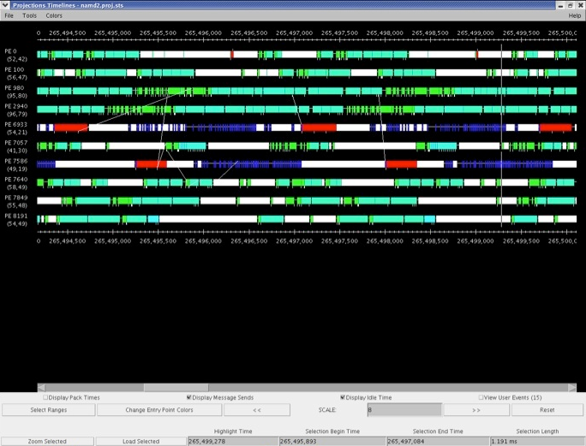
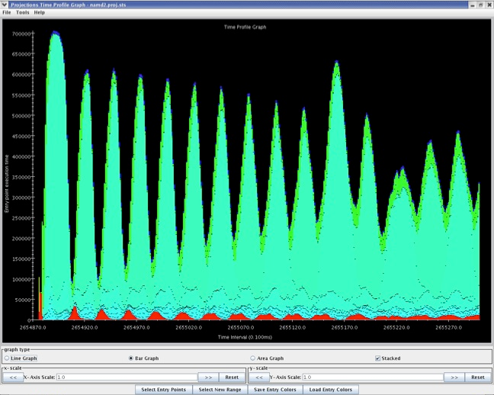
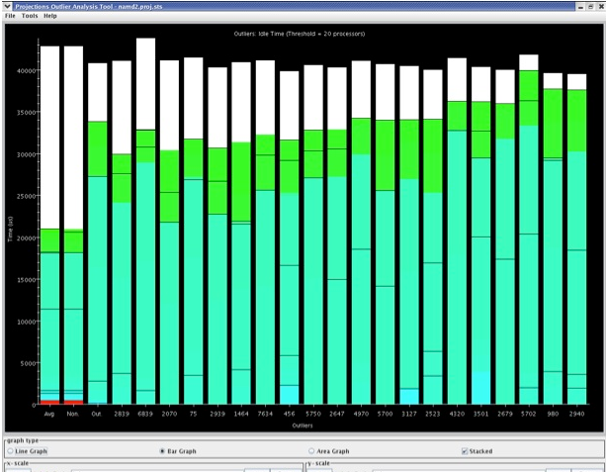
Using the Extrema Tool
Top 20 Least Idle Processors
Notes:
Story: The time profile shows possible load imbalance (using our heuristic).
However, the load balancer indicated balanced load!
What seems to be wrong?
So, pick out the most overloaded processors using the least-idle attribute as a heuristic.
Turns out an activity (indicated by the lime-green color) which was not considered by the load balancing strategy as load, took a significant amount of time when the expectations were for them to be insignificant.
Timelines of the two most extreme processors were picked and loaded by clicking on the bars.
To complete the picture, processors communicating with the offending activities were loaded onto timeline and probed.

Slide 19
Scalable Tool Features: Conclusions
Effective analysis idioms must avoid non-scalable features.
Histograms, Time Profiles and the Extrema Tool offer scalable features in support of idioms.

Slide 20
Main Thrusts
Tool feature support for Scalable Analysis Idioms.
Online reduction of performance data volume.
Analysis Idioms for applications through live performance streaming.
Effective repeated performance hypothesis testing through simulation.

Slide 21
Data Reduction
Normally, scalable tool features are used with full event traces.
What happens if full event traces get too large?
We can:
Choose to keep event traces for only a subset of processors.
Replace event traces of discarded processors with interval-based profiles.
Notes:
Point out the observation that detailed event traces are only needed for a subset of processors we found interesting when forced to study detailed timelines.
Go into a description of interval-based profiles (summary detail) only if asked.
Keep in mind that histograms over flexible time durations of interest also require full event traces. Address only if asked.

Slide 22
Interval-Based Profiles
Small files. File size is a function of duration of instrumentation and resolution of each time interval recorded.
Suitable for Time Profiles.

Slide 23
Choosing Useful Processor Subset (1/2)
What are the challenges?
No a priori information about performance problems in dataset.
Chosen processors need to capture details of performance problems.

Slide 24
Choosing Useful Processor Subsets (2/2)
Observations:
Processors tend to form equivalence classes with respect to performance behavior.
Clustering can be used to discover equivalence classes in performance data.
Outliers in clusters may be good candidates for capturing performance problems.
Notes:
Since outliers represent extreme (and hence, interesting) elements within each cluster.

Slide 25
Applying k-Means Clustering to Performance Data (1/2)
k-Means Clustering algorithm is commonly used to classify objects in data mining applications.
Treat the vector of recorded performance metric values on each processor as a data point for clustering.
Notes:
First, we need to find our clusters before we can choose outliers from them.
We use the simple k-means algorithm.

Slide 26
Applying k-Means Clustering to Performance Data (2/2)
Measure similarity between two data points using the Euclidean Distance between the two metric vectors.
Given k clusters to be found, the goal is to minimize similarity values between all data points and the centroids of the k clusters.

Slide 27
Choosing from Clusters
Choosing Cluster Outliers.
Pick processors furthest from cluster centroid.
Number chosen by proportion of cluster size.
Choosing Cluster Exemplars.
Pick a single processor closest to the cluster centroid.
Outliers + Exemplars = Reduced Dataset.
Notes:
Quicken the pace: Such a simple idea with simple heuristics does not require 1:44
Comment: Reduced Dataset also includes all the interval-based profiles.

Slide 28
Applying k-Means Clustering Online
Decisions on data retention are made before data is written to disk.
Requires a low-overhead and scalable parallel k-Means algorithm which was implemented.
Notes:
We would want to apply the clustering and selection online.
Note that we have implemented such a parallel implementation.

Slide 29
Parallel k-Means
Root
Worker
Contribute metric vector.
Receive aggregated metric vector stats.
Calculate normalization factors.
Get initial cluster centroids.
Broadcast factors and centroids.
Normalize local metric vector.
Find closest centroid.
Contribute centroid modification.
Update centroids.
If no centroid changes,
Done
Else
Broadcast centroids

Slide 30
Important k-Means Parameters
Choice of metrics from domains:
Activity time.
Communication volume (bytes).
Communication (number of messages).
Normalization of metrics:
Same metric domain = no normalization.
Min-max normalization across different metric domains to remove inter-domain bias.
Notes:
In the thesis, the metric values were all chosen from entry method activity time.
If all the chosen performance metrics belong to the same metric domain, then no normalization should be performed.
We want to establish deliberate bias in favor of large absolute variation (values are not important and eliminated when computing Euclidean Distance) where performance data is concerned. There may be situations where small numbers influence performance negatively, but I cannot think of any at the moment.

Slide 31
Min-Max Normalization for Multiple Metric Domains
Find min_{m} values for each metric m over all processor data points.
Find max_{d} values for metrics within each metric domain d over all processor data points.
For each data point, re-compute each metric value m, where m is a member of domain d, as: (m – min_{m})/max_{d}
Notes:
max_{d} should be max over all (m-min_{m}) where m is in domain d.

Slide 32
k-Means Clustering
Metric Y
Metric X

Slide 33
Clustering Nuances
Idle Time

Slide 34
Evaluating the technique
Clustering and choice heuristics presented us with a reduced dataset.
How useful is the reduced dataset to analysis?
We know least-idle processors can be useful for analysis.
How many top least-idle processors will show up in the reduced dataset?
What was the overhead?

Slide 35
Results (2048 Processors NAMD)
Percentage of Top Least Idle processors picked for the reduced dataset.
Top x Least Idle | 5% Retention | 10% Retention | 15% Retention
5 | 100% | 100% | 100%
10 | 70% | 90% | 100%
20 | 45% | 70% | 95%
5% Retention = 102 processors
10% Retention = 204 processors
15% Retention = 306 processors
Notes:
Quicken the pace (1:38 was far too long):
Describe columns = experiments at various levels of processor retention.
Describe rows = what portion of the top were retained.
Data shows a promising retention percentage.

Slide 36
Results (1024 Processors NAMD)
Percentage of Top Least Idle processors picked for the reduced dataset.
Top x Least Idle | 5% Retention | 10% Retention | 15% Retention
5 | 20% | 40% | 60%
10 | 20% | 40% | 50%
20 | 10% | 20% | 30%
5% Retention = 51 processors
10% Retention = 102 processors
15% Retention = 153 processors

Slide 37
Results (4096 Processors NAMD)
Percentage of Top Least Idle processors picked for the reduced dataset.
Top x Least Idle | 2.5% Retention | 5% Retention | 7.5% Retention
5 | 40% | 100% | 100%
10 | 20% | 70% | 100%
20 | 10% | 45% | 100%
2.5% Retention = 102 processors
5% Retention = 204 processors
7.5% Retention = 306 processors

Slide 38
Overhead of parallel k-Means
Notes:
Overhead is higher for small processor counts because time includes parsing trace buffers to compute metric values. For the same problem size, larger logs reside on each processors’ trace buffers.

Slide 39
Data Reduction: Conclusions
Showed combination of techniques for online data reduction is effective*.
Choice of processors included in reduced datasets can be refined and improved
Include communicating processors.
Include processors on critical path.
Consideration of application phases can further improve quality of reduced dataset.
*Chee Wai Lee, Celso Mendes and Laxmikant V. Kale. Towards Scalable Performance Analysis and Visualization through Data Reduction. 13th International Workshop on High-Level Parallel Programming Models and Supportive Environments, Miami, Florida, USA, April 2008.

Slide 40
Main Thrusts
Tool feature support for Scalable Analysis Idioms.
Online reduction of performance data volume.
Analysis Idioms for applications through live performance streaming.
Effective repeated performance hypothesis testing through simulation.

Slide 41
Live Streaming of Performance Data
Live Streaming mitigates need to store a large volume of performance data.
Live Streaming enables analysis idioms that provide animated insight into the trends application behavior.
Live Streaming also enables idioms for the observation of unanticipated problems, possibly over a long run.
Notes:
I sort of feel that long-term problems which cannot be anticipated are a good fit for analysis and discovery through live-streaming. It is something that is infeasible using post-mortem tools.

Slide 42
Challenges to Live Streaming
Must maintain low overhead for performance data to be recorded, pre-processed and disposed-of.
Need efficient mechanism for performance data to be sent via out-of-band channels to one (or a few) processors for delivery to a remote client.
Notes:
Note that it is hard to achieve efficient out-of-band communication in MPI applications, particularly while in user-space.
MRNet organizes groups of external processes for out-of-band communication, but the intermediate processes in the tree has to be allocated away from the application process in order to be efficient.

Slide 43
Enabling Mechanisms
Charm++ adaptive runtime as medium for scalable and efficient:
Control signal delivery.
Performance data capture and delivery.
Converse Client-Server (CCS) enables remote interaction with running Charm++ application through a socket opened by the runtime.
Notes:
To answer those challenges, I have identified the enabling mechanisms via the Charm++ runtime system and implemented the software to exploit the mechanism for our goals.

Slide 44
Questions
What kinds of performance data should we stream?
How frequently should we deliver the data to the client?

Slide 45
Live Streaming System Overview
Notes:
Start Demo video.

Slide 46
What is Streamed?
A Utilization Profile similar to high resolution Time Profiles.
Performance data is compressed by only considering significant metrics in a special format.
Special reduction client merges data from multiple processors.

Slide 47
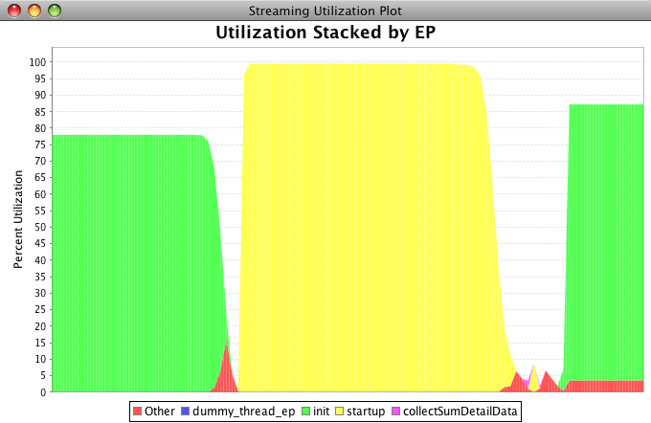
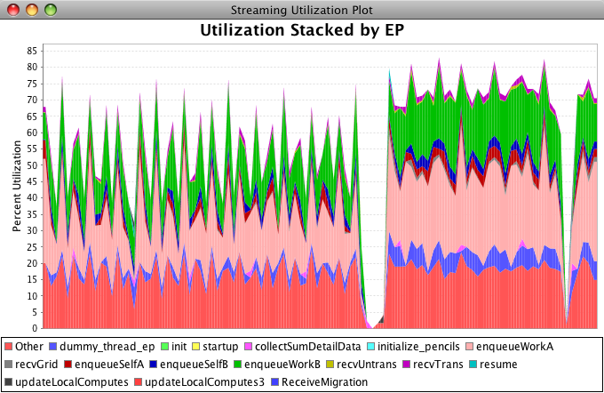
Visualization

Slide 48
Overheads (1/2)
% Overhead when compared to baseline system:
Same application with no performance instrumentation.
 | 512 | 1024 | 2048 | 4096 | 8192
With instrumentation, data reductions to root with remote client attached. | 0.94% | 0.17% | -0.26% | 0.16% | 0.83%
With instrumentation, data reductions to root but no remote client attached. | 0.58% | -0.17% | 0.37% | 1.14% | 0.99%
Notes:
Try to quicken the pace, do not harp on the –ve percentages.

Slide 49
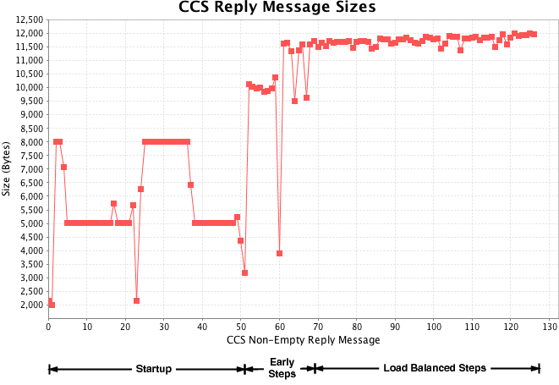
Overheads (2/2)
For bandwidth consumed when streaming performance data to the remote visualization client.

Slide 50
Live Streaming: Conclusions*
Adaptive runtime allowed out-of-band collection of performance data while in user-space.
Achieved with very low overhead and bandwidth requirements.
*Isaac Dooley, Chee Wai Lee, and Laxmikant V. Kale. Continuous Performance Monitoring for Large-Scale Parallel Applications. Accepted for publication at HiPC 2009, December-2009.

Slide 51
Main Thrusts
Tool feature support for Scalable Analysis Idioms.
Online reduction of performance data volume.
Analysis Idioms for long-running applications through live performance streaming.
Effective repeated performance hypothesis testing through simulation.

Slide 52
Repeated Large-Scale Hypothesis Testing
Large-Scale runs are expensive:
Job submission of very wide jobs to supercomputing facilities.
CPU resources consumed by very wide jobs.
How do we make repeated but inexpensive hypothesis testing experiments?
Notes:
Even if you can get extremely wide runs through the job queue relatively fast, it would still be better to pay the costs upfront only once.

Slide 53
Trace-based Simulation
Capture event dependency logs from a baseline application run.
Simulation produces performance event traces from event dependency logs.

Slide 54
Advantages
The time and memory requirements at simulation time are divorced from requirements at execution time.
Simulation can be executed on fewer processors.
Simulation can be executed on a cluster of workstations and still produce the same predictions.

Slide 55
Using the BigSim Framework (1/2)
BigSim emulator captures:
Relative event time stamps.
Message dependencies.
Event dependencies.
BigSim emulator produces event dependency logs.

Slide 56
Using the BigSim Framework (2/2)
BigSim simulator uses a PDES engine to process event dependency logs to predict performance.
BigSim simulator can generate performance event traces based on the predicted run.

Slide 57
Examples of Hypothesis Testing Possible
Hypothetical Hardware changes:
Communication Latency.
Network properties.
Hypothetical Software changes:
Different load balancing strategies.
Different initial object placement.
Different number of processors with the same object decomposition.
Notes:
I have developed software tools to make hypothetical software changes possible for BigSim without explicit modeling requirements for each individual application.

Slide 58
Example: Discovering Latency Trends
Study the effects of network latency on performance of seven-point stencil computation.

Slide 59
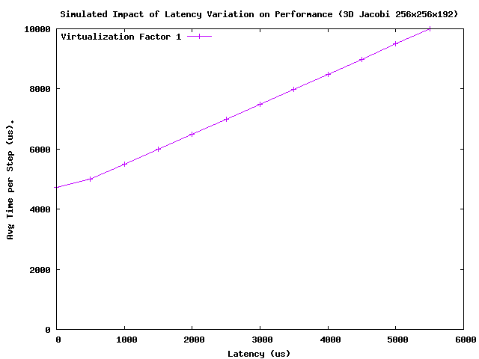
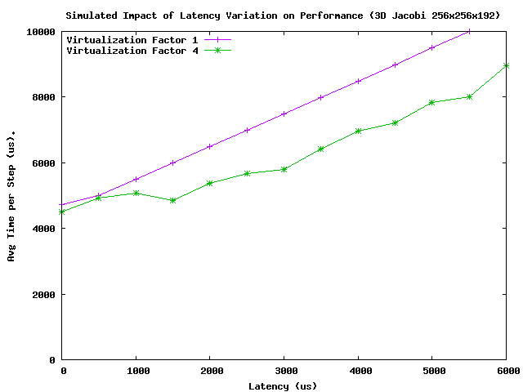
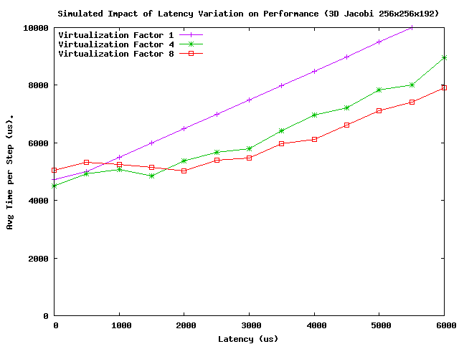
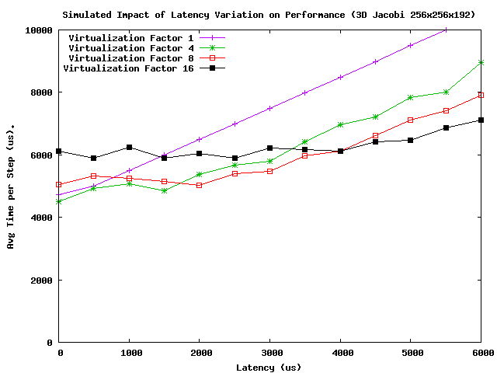
Latency Trends – Jacobi 3d 256x256x192 on 48 pes
Notes:
Speed this up somewhat by explaining virtualization factors quicker!
Question: Does the adaptive runtime help with increased latency? Yes, how do we show that?
Virtualization factor 1 = 64x64x64 blocks per chare.
Factor 2 = 64x32x64, 4 = 64x32x32, 8 = 32x32x32, 16 = 32x16x32.
Story – Event dependency log captured at VP1, trend points collected from simulation.
What happens if I varied the virtualization factor?
Re-run the experiments at full scale for VP4, 8 and 16.
Trends are collected from simulation again.

Slide 60
Testing Different Load Balancing Strategies (1/2)
Load Balancing Strategies make decisions as object-to-processor maps based on object load and inter-object communication costs.
How do we make the simulator produce predictions about new load balancing strategies without re-executing the original code?

Slide 61
Testing Different Load Balancing Strategies (2/2)
Record object-load and communication information of baseline run.
Different Load Balancing strategies create different object-to-processor maps.
A log transformation tool I wrote, transforms event dependency logs to reflect new object-to-processor mapping.
Notes:
Object to processor map produced by new load balancing strategy.
Mention the log transformation tool

Slide 62
Example: Load Balancing Strategies
Baseline Load Imbalance: Half the processors perform twice the work with 2 objects per processor.
Greedy Strategy: Objects balanced across processors perfectly.

Slide 63
Reduction of Processors during Emulation
BigSim emulator can emulate k processors on p physical processors
Ratio of k to p can be increased by memory aliasing where appropriate.

Slide 64
Hypothesis Testing: Conclusions
Flexible repeated performance hypothesis testing can be achieved via trace-based simulation.
No analytical models need to be constructed for each application to enable software changes such as load balancing strategies.

Slide 65
Extending Scalability Techniques
Can the techniques described in this thesis be adopted by other tools quickly?
This was investigated through the results of a collaboration with the TAU group*.
Flexible Performance call-back interface in Charm++ enabled an easy mechanism for a popular tool like TAU to record and process key runtime and application events.
*Scott Biersdorff, Chee Wai Lee, Allen D. Malony and Laximkant V. Kale. Integrated Performance Views in Charm++: Projections Meets TAU. ICPP-2009, Vienna, Austria, September 22-25, 2009.

Slide 66
Benefits of Extension of Capabilities
Scalable TAU tools features can be used to grant different performance insights into Charm++ applications.
TAU can make use of the adaptive runtime for live streaming of TAU data.
TAU can make use of BigSim for repeated hypothesis testing.

Slide 67
Thesis Contributions (1/2)
Identified and developed scalable tool feature support for performance analysis idioms.
Showed the combination of techniques and heuristics effective for data reduction.
Showed how an adaptive runtime can efficiently stream live performance data out-of-band in user-space to enable powerful analysis idioms.

Slide 68
Thesis Contributions (2/2)
Showed trace-based simulation to be an effective method for repeated hardware and software hypothesis testing.
Highlighted importance of flexible performance frameworks for the extension of scalability features to other tools.

