Slide 1
The Charm++ Programming Model and NAMD
Abhinav S Bhatele
Department of Computer Science
University of Illinois at Urbana-Champaign
http://charm.cs.uiuc.edu
E-mail: bhatele@illinois.edu

Slide 2
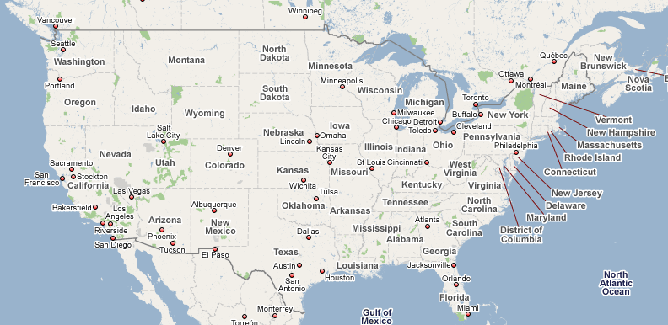
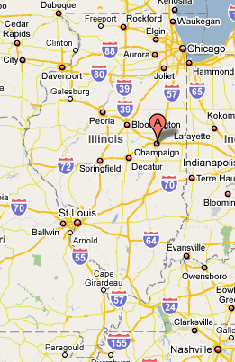
University of Illinois
Urbana-Champaign,
Illinois, USA

Slide 3
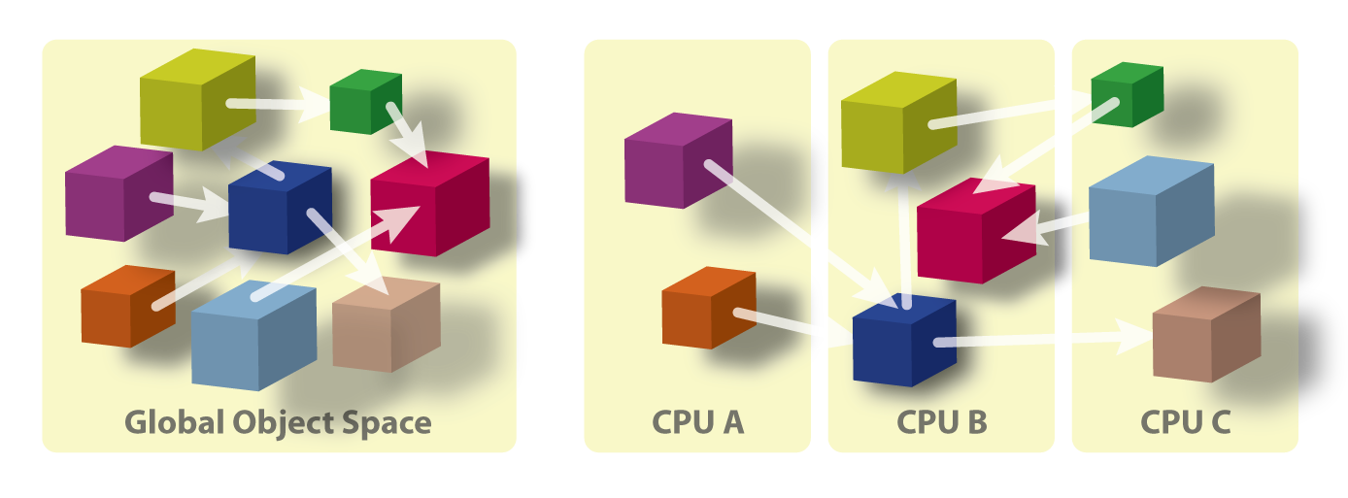
Processor Virtualization
Programmer: Decomposes the computation into objects
Runtime: Maps the computation on to the processors
User View
System View

Slide 4
Benefits of the Charm++ Model
Software Engineering
Number of VPs independent of physical processors
Different sets of VPs for different computations
Dynamic Mapping
Load balancing
Change the set of processors used
Message-driven execution
Compositionality
Predictability

Slide 5
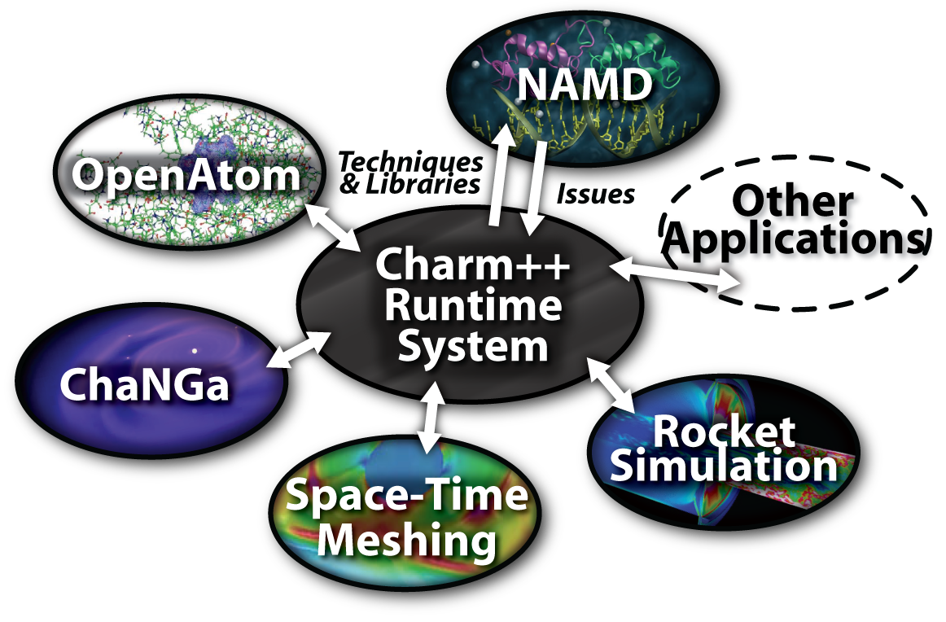
Charm++ and CSE Applications
Fine-grained CPAIMD
Gordon Bell Award, SC 2002
Cosmological Simulations

Slide 6
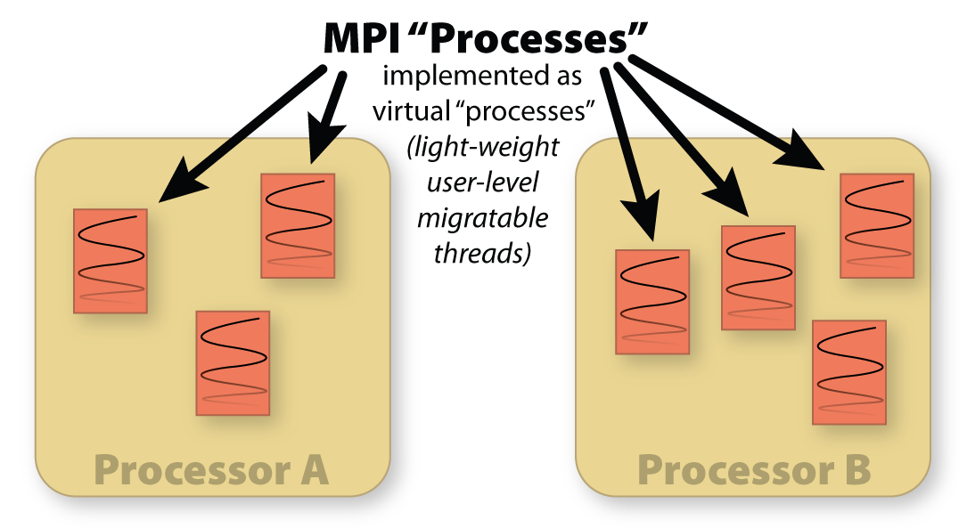
Adaptive MPI (AMPI)
MPI “Processes” - Implemented as virtual “processes” (light-weight user level migratable threads)

Slide 7
Load Balancing
Based on Principle of Persistence
Runtime instrumentation
Measures communication volume and computation time
Measurement based load balancers
Use the instrumented data-base periodically to make new decisions
Many alternative strategies can use the database
Centralized vs distributed
Greedy improvements vs complete reassignments
Taking communication into account

Slide 8
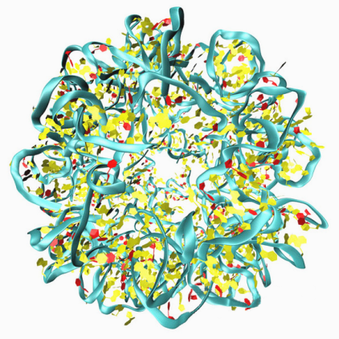
NAMD
NAnoscale Molecular Dynamics
Simulates the life of bio-molecules
Simulation window broken down into a large number of time steps (typically 1 fs each)
Forces on each atom calculated every step
Positions and velocities updated and atoms migrated to their new positions

Slide 9
Parallelization of NAMD
Hybrid Decomposition

Slide 10
Control Flow

Slide 11
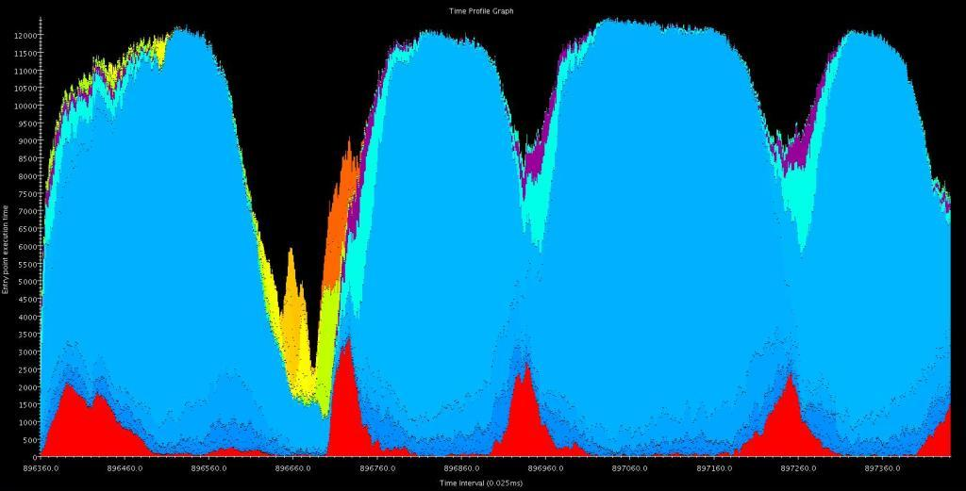
Non-bonded Work
Communication
PME
Bonded Work
Integration

Slide 12
Optimizations on MareNostrum
Fixes to the CVS version
Crash due to a xlc compiler bug
Performance analysis
Using Projections performance analysis tool
Performance tuning
Configuration parameters for NAMD to enable high parallelization

Slide 13
Performance Tuning
Increasing the number of objects
twoAway{X, Y, Z} options
Choice of PME implementation
Slab (1D) vs. Pencil (2D) decomposition
Offloading processors doing PME
Use of spanning tree for communication

Slide 14
DD on MareNostrum

Slide 15
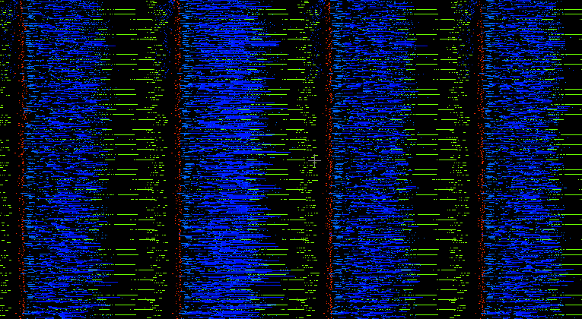
DD with Slab PME

Slide 16
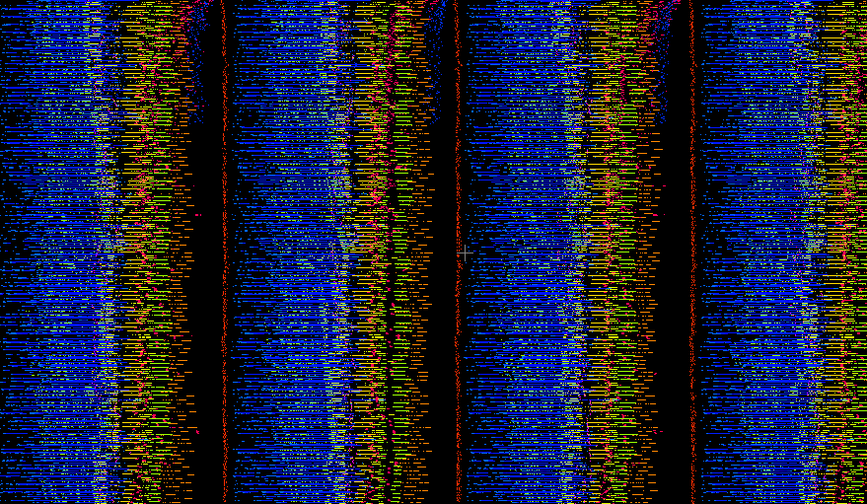
DD with Pencil PME

Slide 17
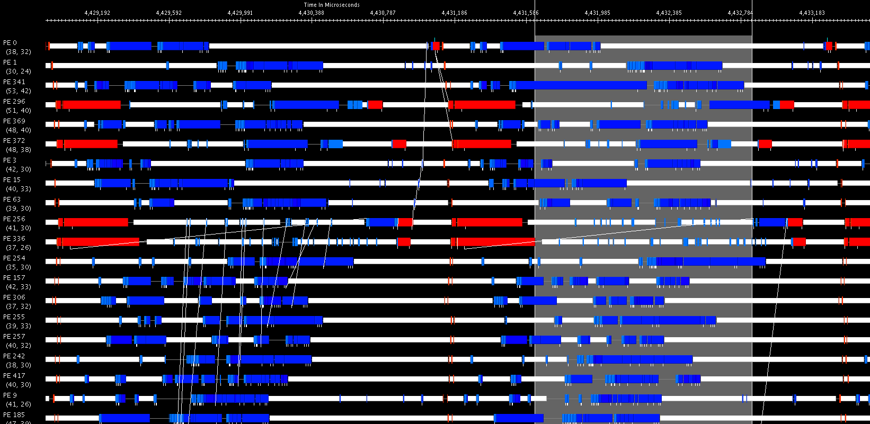
Problem?
1.2 ms

Slide 18
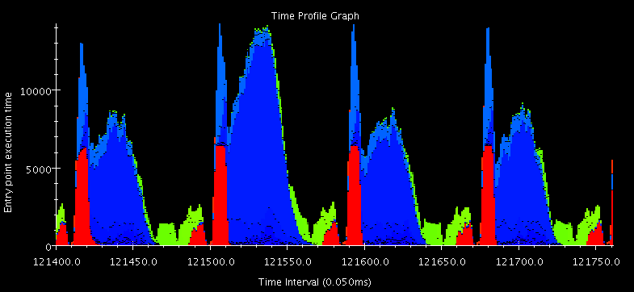

Slide 19
Nucleosome on MareNostrum

Slide 20
Membrane on MareNostrum

Slide 21
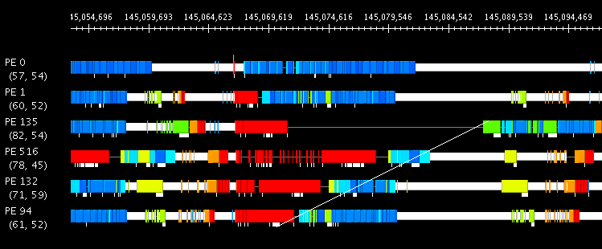
Similar Problem?
Bandwidth on Myrinet: 250 MB/s
Expected Latency for 6-10 KB messages < 0.1 ms
16 ms

Slide 22
Optimizations on the Xe Cluster
Getting the CVS version running (over mpi)
Trying a development version of charm
Runs directly over Infiniband (ibverbs)
Currently unstable

Slide 23
DD on Xeon Cluster

Slide 24
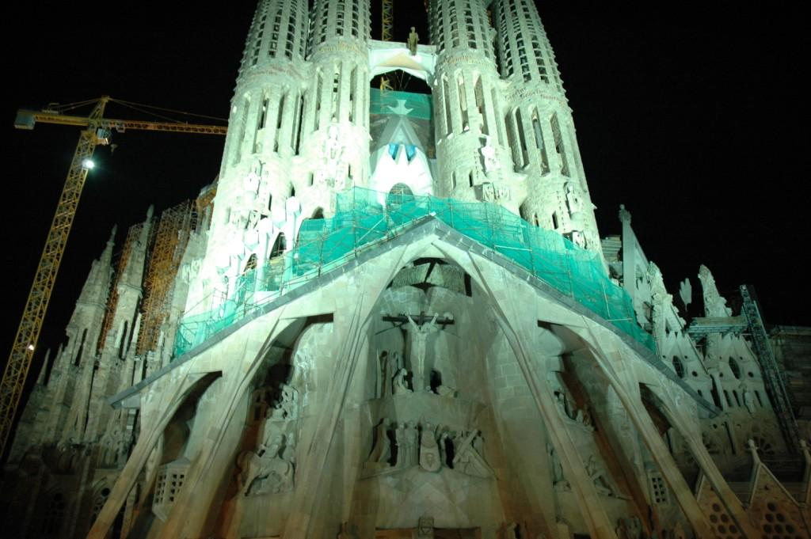
Thank You!

