Slide 1
Topology Aware Mapping for Performance Optimization of Science Applications
Abhinav S Bhatele
Parallel Programming Lab, UIUC

Slide 2
Outline
The Mapping Problem
Motivation for Topology Aware Mapping
NAMD: Dynamic Unstructured Graph
OpenAtom: Static Structured Graph
Other Applications
Automated Mapping Framework

Slide 3
Outline
The Mapping Problem
Motivation for Topology Aware Mapping
NAMD: Dynamic Unstructured Graph
OpenAtom: Static Structured Graph
Other Applications
Automated Mapping Framework

Slide 4
The Mapping Problem
Given a set of communicating parallel “entities”, map them onto physical processors
Entities
Ranks in case of an MPI program
Objects in case of a Charm++ program
Aim
Balance load
Minimize communication traffic

Slide 5
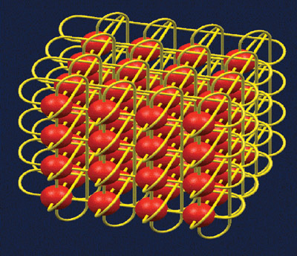
Target Machines
3D torus/mesh interconnects
In a torus, diameter is reduced by half
More paths for adaptive routing
Unlike fat-trees
Not asymptotically scalable

Slide 6
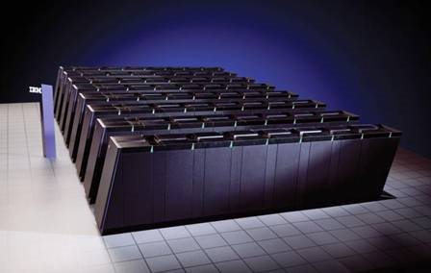
Scale of Parallel Machines
Blue Gene/P at ANL: 40,960 nodes, torus dimensions 32 x 32 x 40 (?)
Jaguar (XT4) at ORNL: 8,064 nodes, torus dimensions 21 x 16 x 24

Slide 7
Outline
The Mapping Problem
Motivation for Topology Aware Mapping
NAMD: Dynamic Unstructured Graph
OpenAtom: Static Structured Graph
Other Applications
Automated Mapping Framework

Slide 8
Motivation
Consider a 3D mesh/torus interconnect
Message latencies can be modeled by
(L_{f}/B) x D + L/B

Slide 9
MPI Tests on Cray XT3

Slide 10
OpenAtom Performance on Blue Gene/L

Slide 11
OpenAtom Performance on Blue Gene/L

Slide 12
Outline
The Mapping Problem
Motivation for Topology Aware Mapping
NAMD: Dynamic Unstructured Graph
OpenAtom: Static Structured Graph
Other Applications
Automated Mapping Framework

Slide 13
Molecular Dynamics
A system of [charged] atoms with bonds
Use Newtonian Mechanics to find the positions and velocities of atoms
Each time-step is typically in femto-seconds
At each time step
calculate the forces on all atoms
calculate the velocities and move atoms around
Notes:
Motivate why is it challenging to parallelize: Generally a few thousand atoms,
one time-step is a few seconds
This needs to be parallelized onto a large number of processors.
The no. of time-steps is large (million to billion) since interesting phenomena happens on the scale of ns or ms
1 fs = 10-15 secs

Slide 14
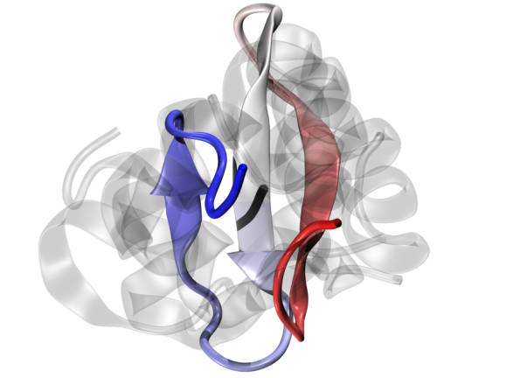
NAMD: NAnoscale Molecular Dynamics
Naïve force calculation is O(N²)
Reduced to O(N logN) by calculating
Bonded forces
Non-bonded: using a cutoff radius
Short-range: calculated every time step
Long-range: calculated every fourth time-step (PME)
Notes:
The Particle-Mesh Ewald algorithm is used, which transfers the electric charge of each atom to electric potential on a grid and uses a 3D FFT to calculate the influence of all
atoms on each atom.

Slide 15
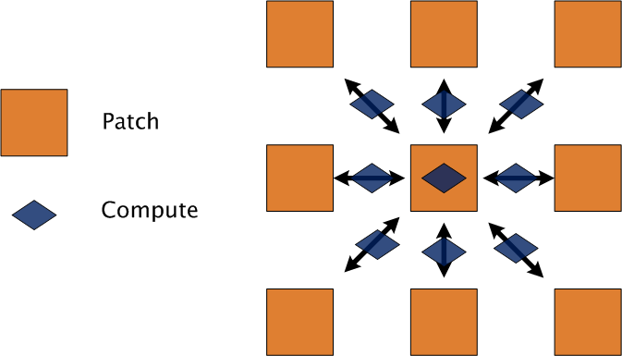
NAMD’s Parallel Design
Hybrid of spatial and force decomposition
Notes:
Patches are assigned statically
Computes are migratable (non-bonded ones) controlled by LDB
Comm to comp ratio is constant

Slide 16
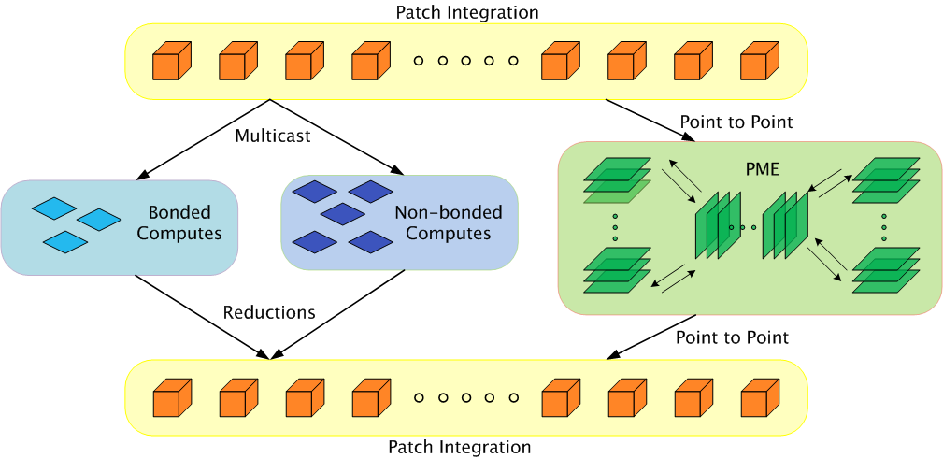
Parallelization using Charm++
Static Mapping
Load Balancing
Bhatele, A., Kumar, S., Mei, C., Phillips, J. C., Zheng, G. & Kale, L. V. 2008 Overcoming Scaling Challenges in Biomolecular Simulations across Multiple Platforms. In Proceedings of IEEE International Parallel and Distributed Processing Symposium, Miami, FL, USA, April 2008.

Slide 17
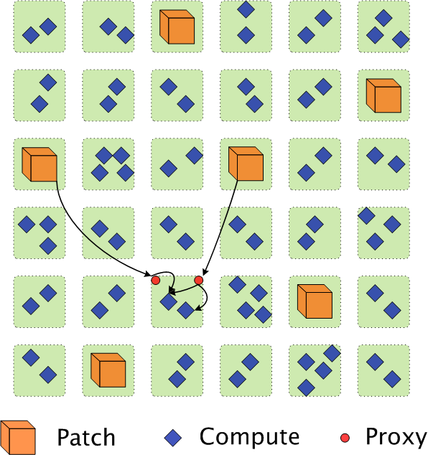
Communication in NAMD
Each patch multicasts its information to many computes
Each compute is a target of two multicasts only
Use ‘Proxies’ to send data to different computes on the same processor

Slide 18
Load Balancing in Charm++
Principle of Persistence
Object communication patterns and computational loads tend to persist over time
Measurement-based Load Balancing
Instrument computation time and communication volume at runtime
Use the database to make new load balancing decisions

Slide 19
NAMD’s Load Balancing Strategy
NAMD uses a dynamic centralized greedy strategy
There are two schemes in play:
A comprehensive strategy (called once)
A refinement scheme (called several times during a run)
Algorithm:
Pick a compute and find a “suitable” processor to place it on

Slide 20
Choice of a suitable processor
Among underloaded processors, try to:
Find a processor with the two patches or their proxies
Find a processor with one patch or a proxy
Pick any underloaded processor
Highest Priority
Lowest Priority
Notes:
Preference to load, then number of proxies

Slide 21
Load Balancing Metrics
Load Balance: Bring Max-to-Avg Ratio close to 1
Communication Volume: Minimize the number of proxies
Communication Traffic: Minimize hop bytes
Hop-bytes = Message size X Distance traveled by message
Agarwal, T., Sharma, A., Kale, L.V. 2008 Topology-aware task mapping for reducing communication contention on large parallel machines, In Proceedings of IEEE International Parallel and Distributed Processing Symposium, Rhodes Island, Greece, April 2006.

Slide 22
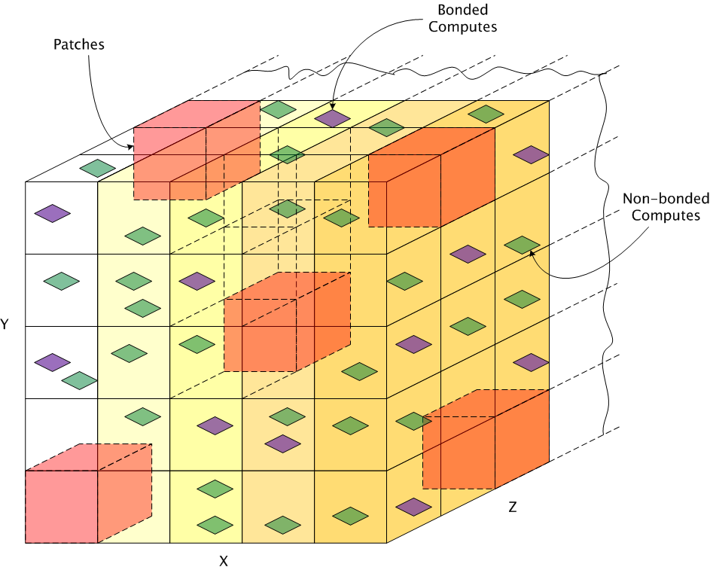
Topology Aware Techniques
Static Placement of Patches

Slide 23
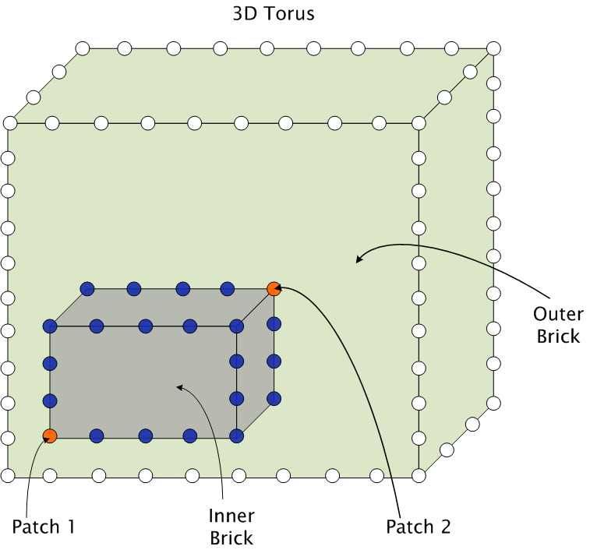
Topology Aware Techniques (contd.)
Placement of computes

Slide 24
Results: Hop-bytes

Slide 25
Results: Performance

Slide 26
Outline
The Mapping Problem
Motivation for Topology Aware Mapping
NAMD: Dynamic Unstructured Graph
OpenAtom: Static Structured Graph
Other Applications
Automated Mapping Framework

Slide 27
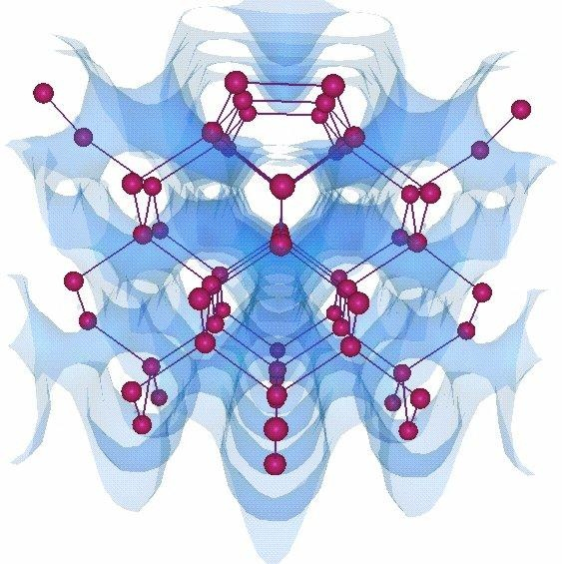
OpenAtom
Ab-Initio Molecular Dynamics code
Communication is static and structured
Challenge: Multiple groups of objects with conflicting communication patterns

Slide 28
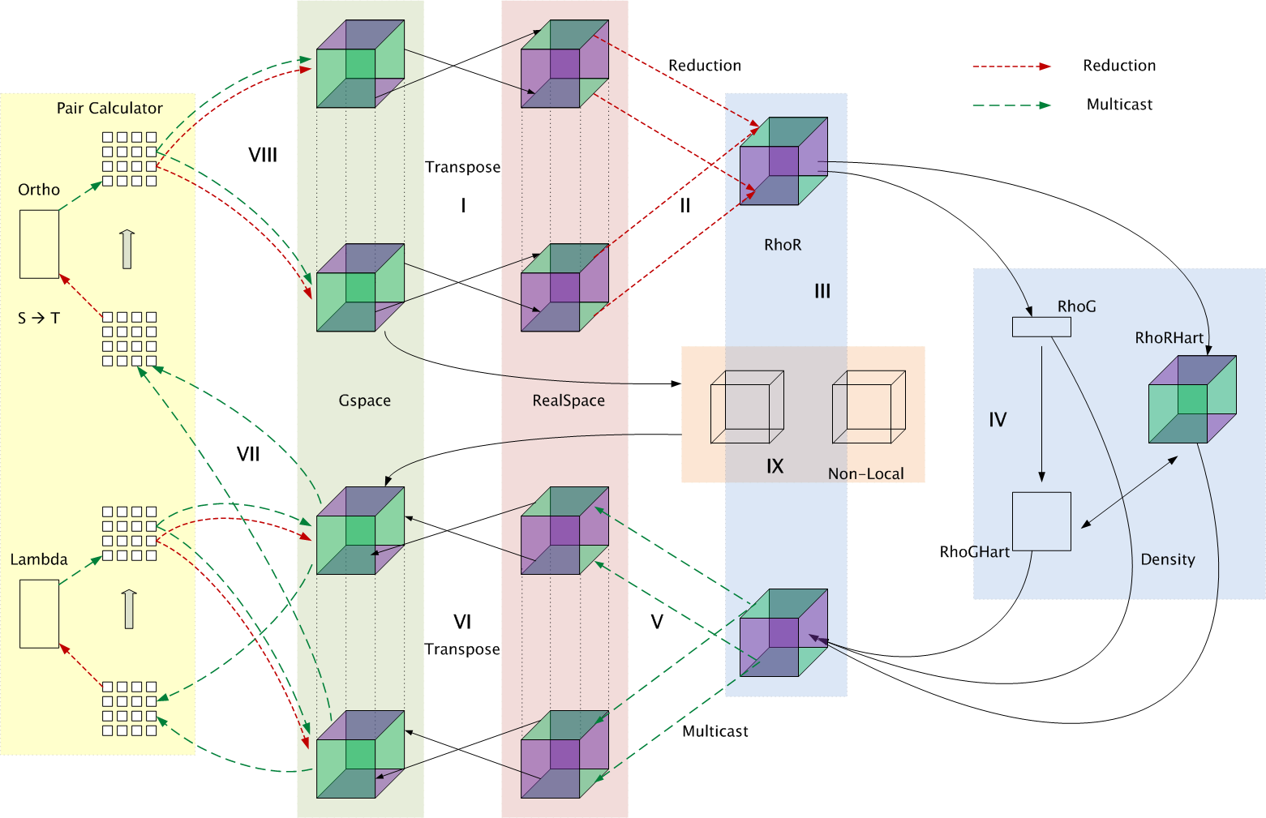
Parallelization using Charm++

Slide 29
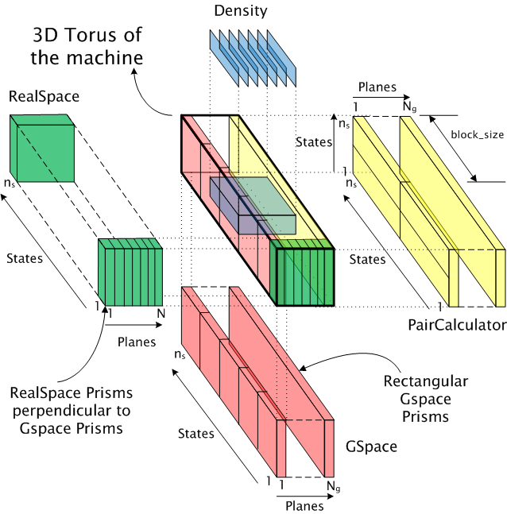
Topology Mapping of Chare Arrays

Slide 30
Visualization of Mapping Solutions
Paraview

Slide 31
Results on Blue Gene/P (ANL)

Slide 32
Results on XT3 (BigBen)

Slide 33
Outline
The Mapping Problem
Motivation for Topology Aware Mapping
NAMD: Dynamic Unstructured Graph
OpenAtom: Static Structured Graph
Other Applications
Automated Mapping Framework

Slide 34
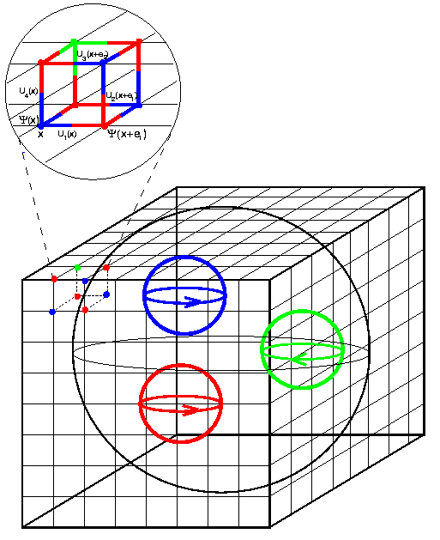
Other Applications
Lattice QCD (Quantum Chromodynamics) Collaboration
Near-neighbor communication
MILC (MIMD Lattice Computation)
Static Structured communication
Map 4D grid to 3D mesh

Slide 35
Outline
The Mapping Problem
Motivation for Topology Aware Mapping
NAMD: Dynamic Unstructured Graph
OpenAtom: Static Structured Graph
Other Applications
Automated Mapping Framework

Slide 36
Requirements
Processor topology graph
Communication Graph
Efficient and scalable mapping algorithms
Heuristics in many cases

Slide 37
Topology Manager API
The application needs information such as
Dimensions of the partition
Rank to physical co-ordinates and vice-versa
TopoManager API
On BG/L and BG/P: provides a wrapper for system calls
On XT3 and XT4, there are no such system calls
Extract this information in various ways and provide a clean interface to the application

Slide 38
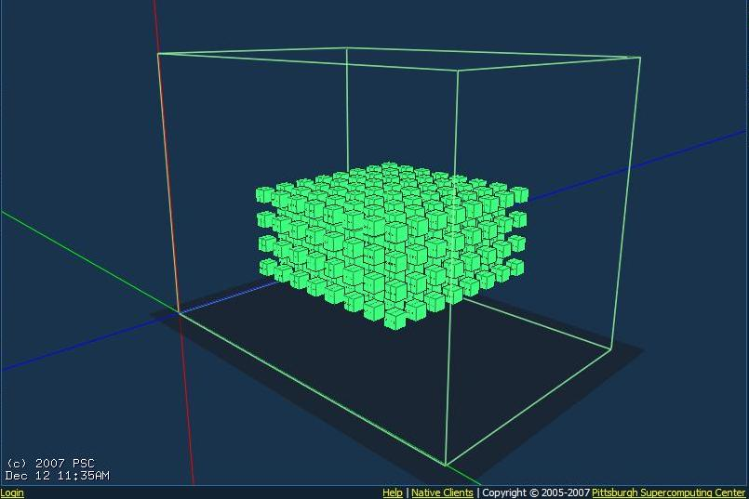
Cray XT3 (BigBen)

Slide 39
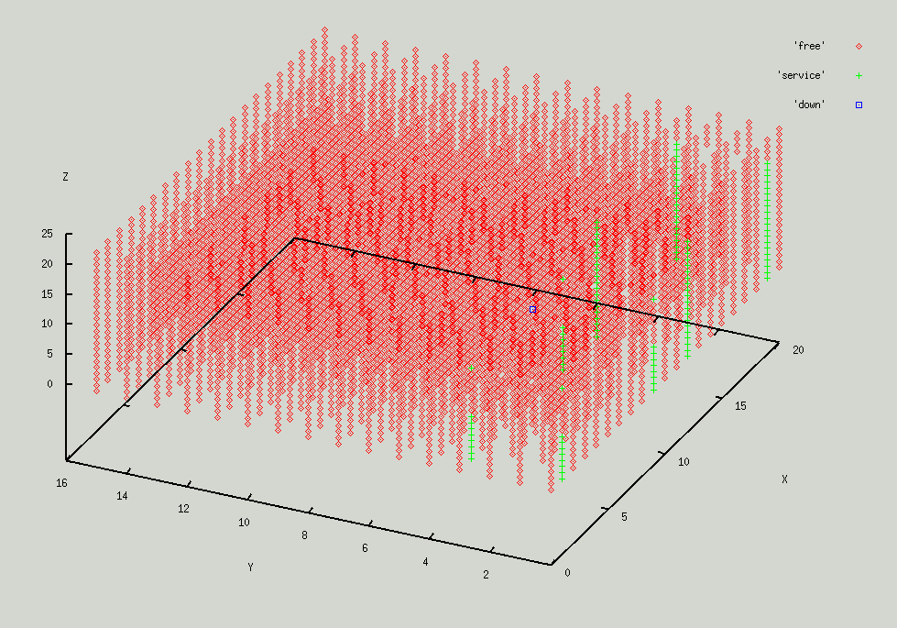
Cray XT4 (Jaguar)

Slide 40
Communication Scenarios
Static Regular Graph: 3D Stencil, Matrix Multiplication, Structured Mesh applications such as MILC
Static Irregular Graph: Unstructured Mesh applications
Dynamic Communication Graph: MD codes, Unstructured Mesh codes with AMR

Slide 41
Automatic Mapping Framework
Obtain the communication graph (previous run, at runtime, compile time)
Apply heuristic techniques for different scenarios to arrive at a mapping solution automatically

Slide 42
Thanks!

