Slide 1
CloudAscent
Propensity model leveraging transactional customer data for SMB partners
Katie Fullmer
CloudAscent Microsoft Program Manager

Slide 2
What Is CloudAscent
CloudAscent is a set of ML models provided from the SMC-SMB team at Microsoft. These models provide propensity data for Customers likelihood to purchase by Solution Area (M365, D365, Azure, Security) and in some cases specific Microsoft products. This is joined with the Solution Plays/Cohorts that drive the Microsoft targeting initiatives.
In this deck you will find:
A step by step guide to get CloudAscent downloads from Partner Center
Directional approach for how to use the data and reference to the marketing materials available
How to target customers for upsell and cross sell

Slide 3
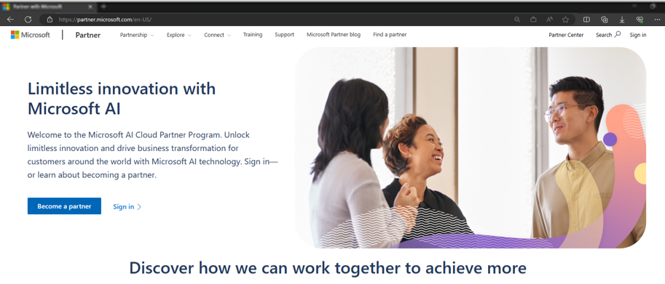
Accessing through partner center
1
Navigate to https://partner.microsoft.com/ & select Partner Center.
1
2
Sign in using your company email.
2
Notes:
CloudAscent surfaces transacting SMB customer data for partners to download from Partner Center. These steps provide a description of how to access propensity data for your transactional customers.

Slide 4
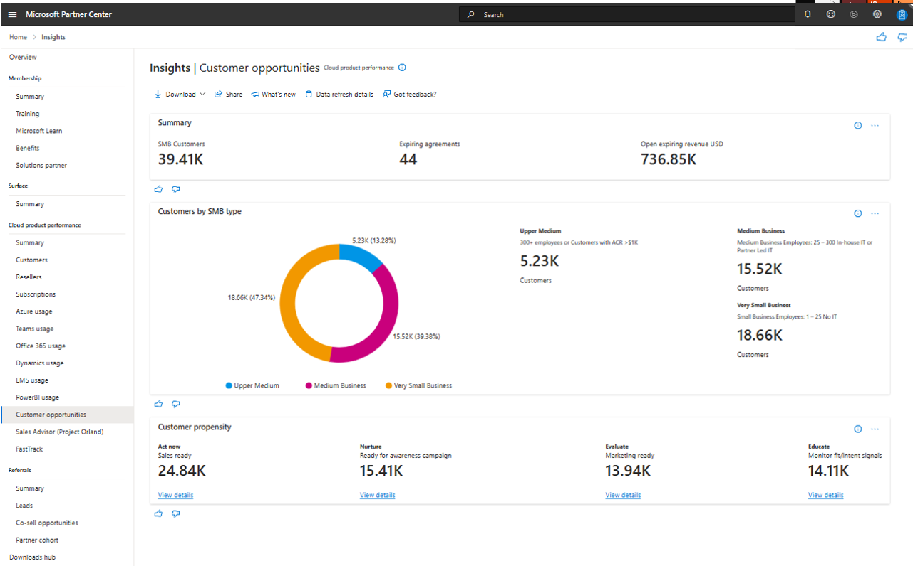
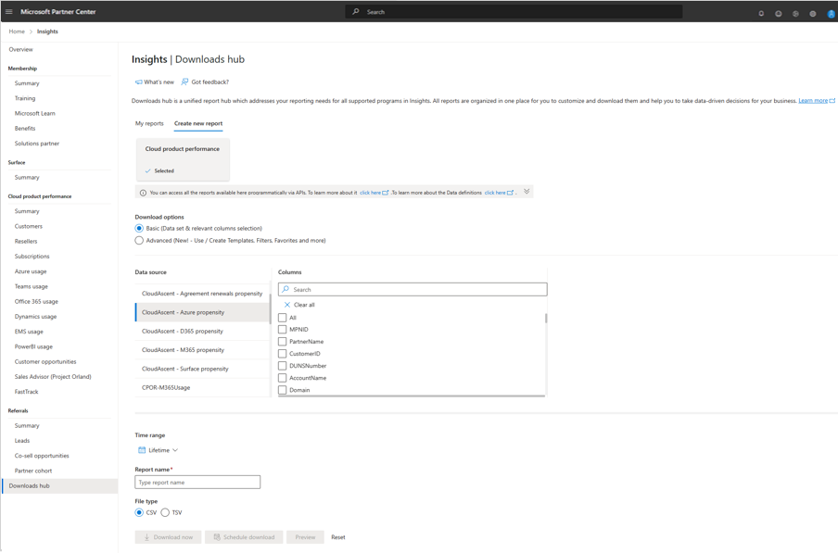
Getting started
3
To download the report insights into Excel, Select the Downloads Hub in the left-hand navigation.
3
4
Within the Downloads Hub, Create a new report, ensure you have Cloud product performance selected and have chosen the Basic Download option.
Under Data Source, you can select any of the 5 CloudAscent Propensity data reports identified by the “CloudAscent–Title” (M365, D365, Azure, Surface, Security, Renewals).
To download select the columns to include in your report, add a report name, select CSV file type and Download now.
4
Notes:
You’ll need to download D365, M365, Azure, and renewals individually to see product propensity recommendations and sales plays for your customers.
selecting the download from the Customer Opportunities tab,

Slide 5
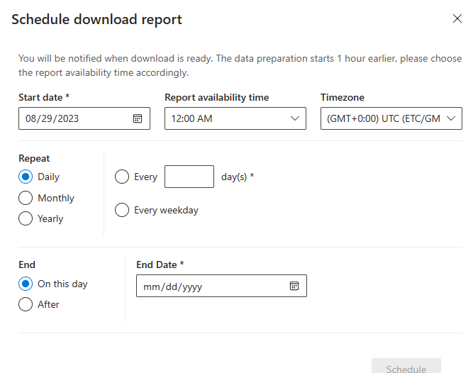
Propensity reports
5
Once open, each file starts with your own Partner ID/Name, followed by your customer firmographics data, and propensity recommendations.
Target the act now and evaluate propensity clusters for the highest yield customers.
5
6
Set up to receive reports on a recurring bases.
6
Notes:
Your customers will be scored for all products including those they own. For Azure and O365, upsell propensity is also provided look for the Azure Upsell/O365 Upsell columns.

Slide 6
Download Highlights
4
Solution Plays/Cohorts: For Azure, D365 and Security: use the yes/no indicator to determine if the customer is part of the Solution Play. For M365 and Surface, the data shows the cohort name. Use Microsoft Learn to get the cohort definitions
1
Your own partner information: Global ID, PartnerName
2
Key Customer Firmographic Attributes: Customer Name, Domain, Org Size, City, State, Postal Code, Industry, Vertical, Segment, Sub Segment
5
Propensity:
M365 – M365, Surface, and M365 upsell potential
D365 - D365 Business Essentials, D365 Sales Pro, and Power Apps
Azure – Azure, & Azure next logical workload
3
SMC Type Summary: Customer Segmentation into Upper Medium, Medium, and Small Business to define customer size and potential
1
2
3
4
5

Slide 7
General report usage guidelines
1
Scroll to the section on propensity (Example: Azure Cluster, M365 Cluster,…etc), Filter on Act Now, Evaluate to get the high propensity customers
3
Apply additional filters that may be applicable to your business case. Example: Org Size, Industry, Vertical, Country
4
Match the list of Customers to your internal CRM system to align contactability data, Use http://aka.ms/smbgtm to align cohorts and content
2
Leverage the Solution Plays/Cohorts to determine which customers are in which campaign
5
Login to DMC to use the existing campaign materials provided to partners free of cost from Microsoft. Use the marketing material associated to the solution play/cohort that you filtered on and run a campaign with these customers.

Slide 8
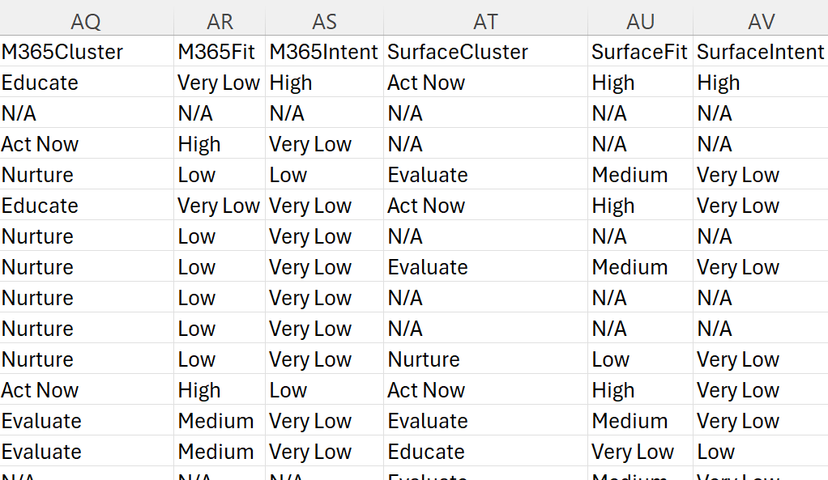
How to use CloudAscent Downloads
1
Propensity Columns in each download:
Azure Download
M365 Download
1
Scroll to the section on propensity (Example: Azure Cluster, M365 Cluster,…etc), Filter on Act Now, Evaluate to get the high propensity customers
Product propensity that is selected depends on the associated Solution Play/Cohort that you pair this with.
For example, D365 has 3 models and the Solution Plays/Cohorts should be used with the model noted in the solution play/cohort title.
D365 Download
The Business Central model is defined to support customers with less than 300 employees. This provides a comprehensive business management solution designed for small to medium-sized businesses
The Sales Pro model is defined to support CRM for all customer employee levels.
The Power Apps Model is applied to customers with competitors in equivalent systems

Slide 9
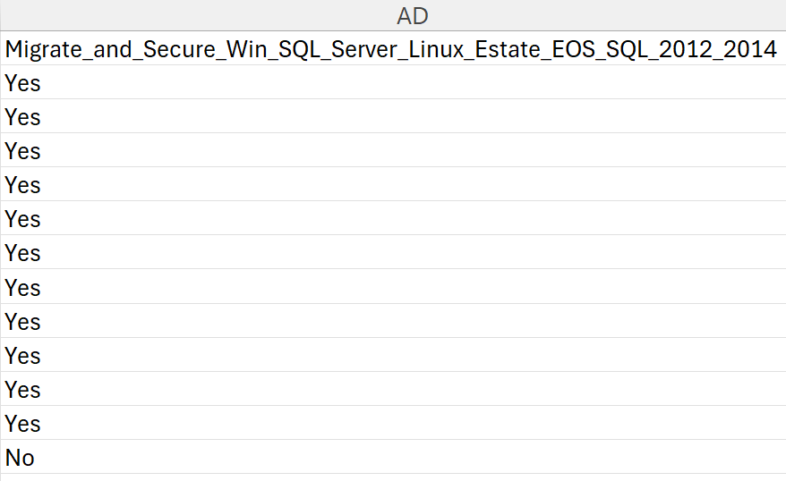
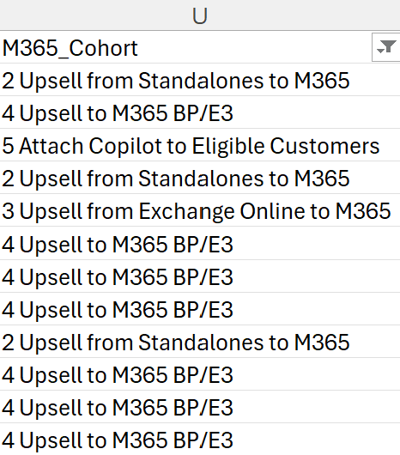
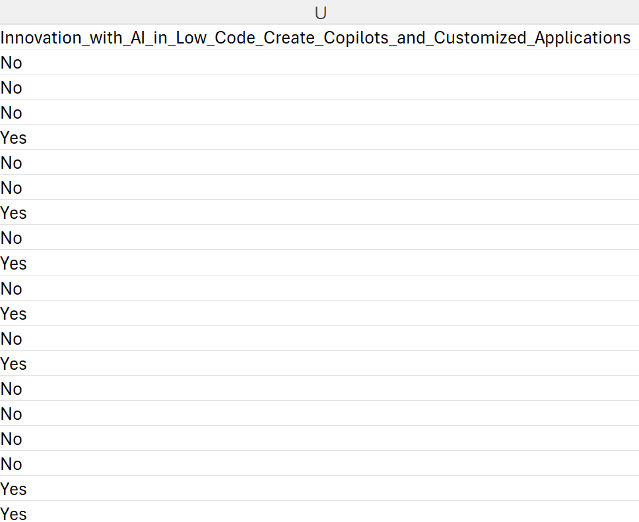
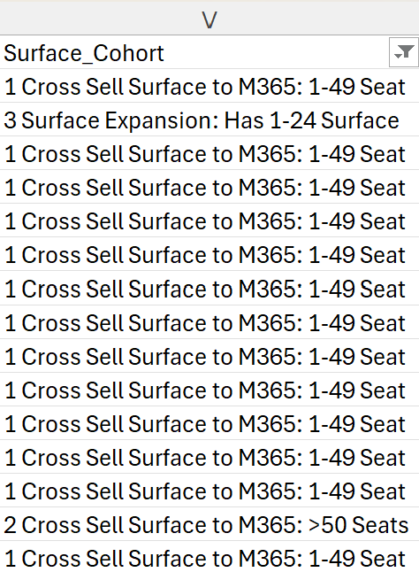
How to Use CloudAscent Downloads
2
Example Solution Play/Cohorts in each download:
Azure Download
M365 Download
2
Leverage the Solution Plays/Cohorts to determine which customers are in which campaign
As an example, I’ve selected a Solution Play/Cohort from each download. Filter this to yes for Azure or D365 to select the customers who meet the criteria for this Solution Play/Cohort. For MW and Surface the name of the Cohort is included in the column, filter on the cohort name.
The solution play/Cohort Name is sharing the details of the targeting scenario and what model should be leveraged.
D365 Download
Surface Download

Slide 10
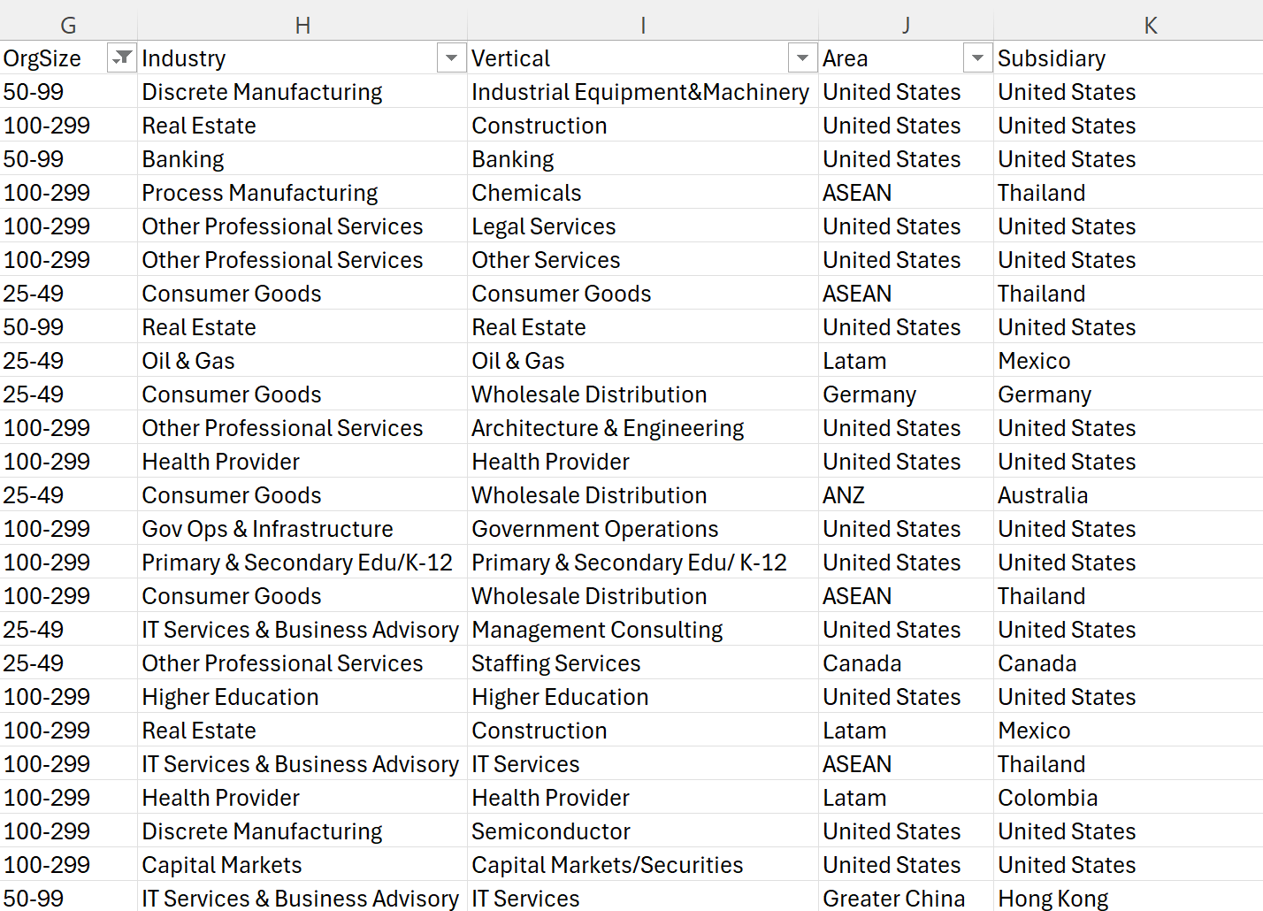
How to Use CloudAscent Downloads
3
Example firmographics data available in all downloads:
3
Apply additional filters that may be applicable to your business case
CloudAscent provides customer firmographics data at the beginning of each download. These fields can be used to filter the data to further tailor targeting. The firmographics data will be the same in all downloads.
The example shows data filtered to 25-299 employees with groupings broken out into 25-49, 50-99, and 100-299. Industry, Vertical, Subsidiary also might be filters that you apply.

Slide 11
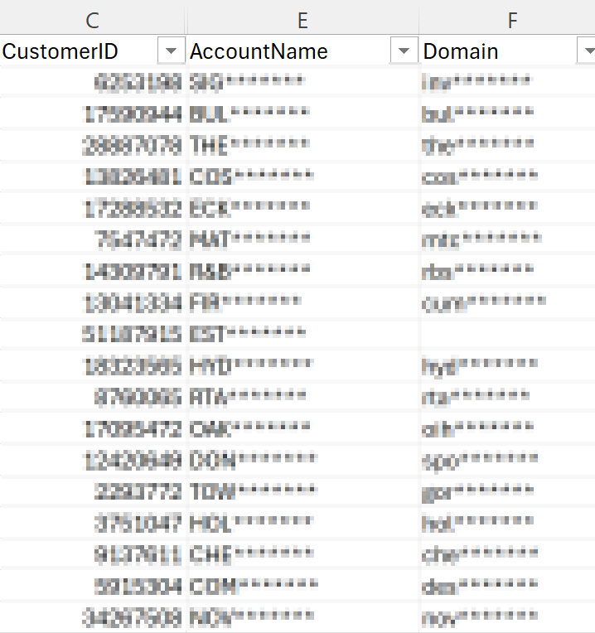
How to Use CloudAscent Downloads
4
Example Unique Customer Identifiers in all downloads:
4
For each customer, CloudAscent shares the customer name and domain.
To match your internal CRM system, use the below unique identifiers:
domain
customer’s name
customer ID (This is the Microsoft TPID)

Slide 12
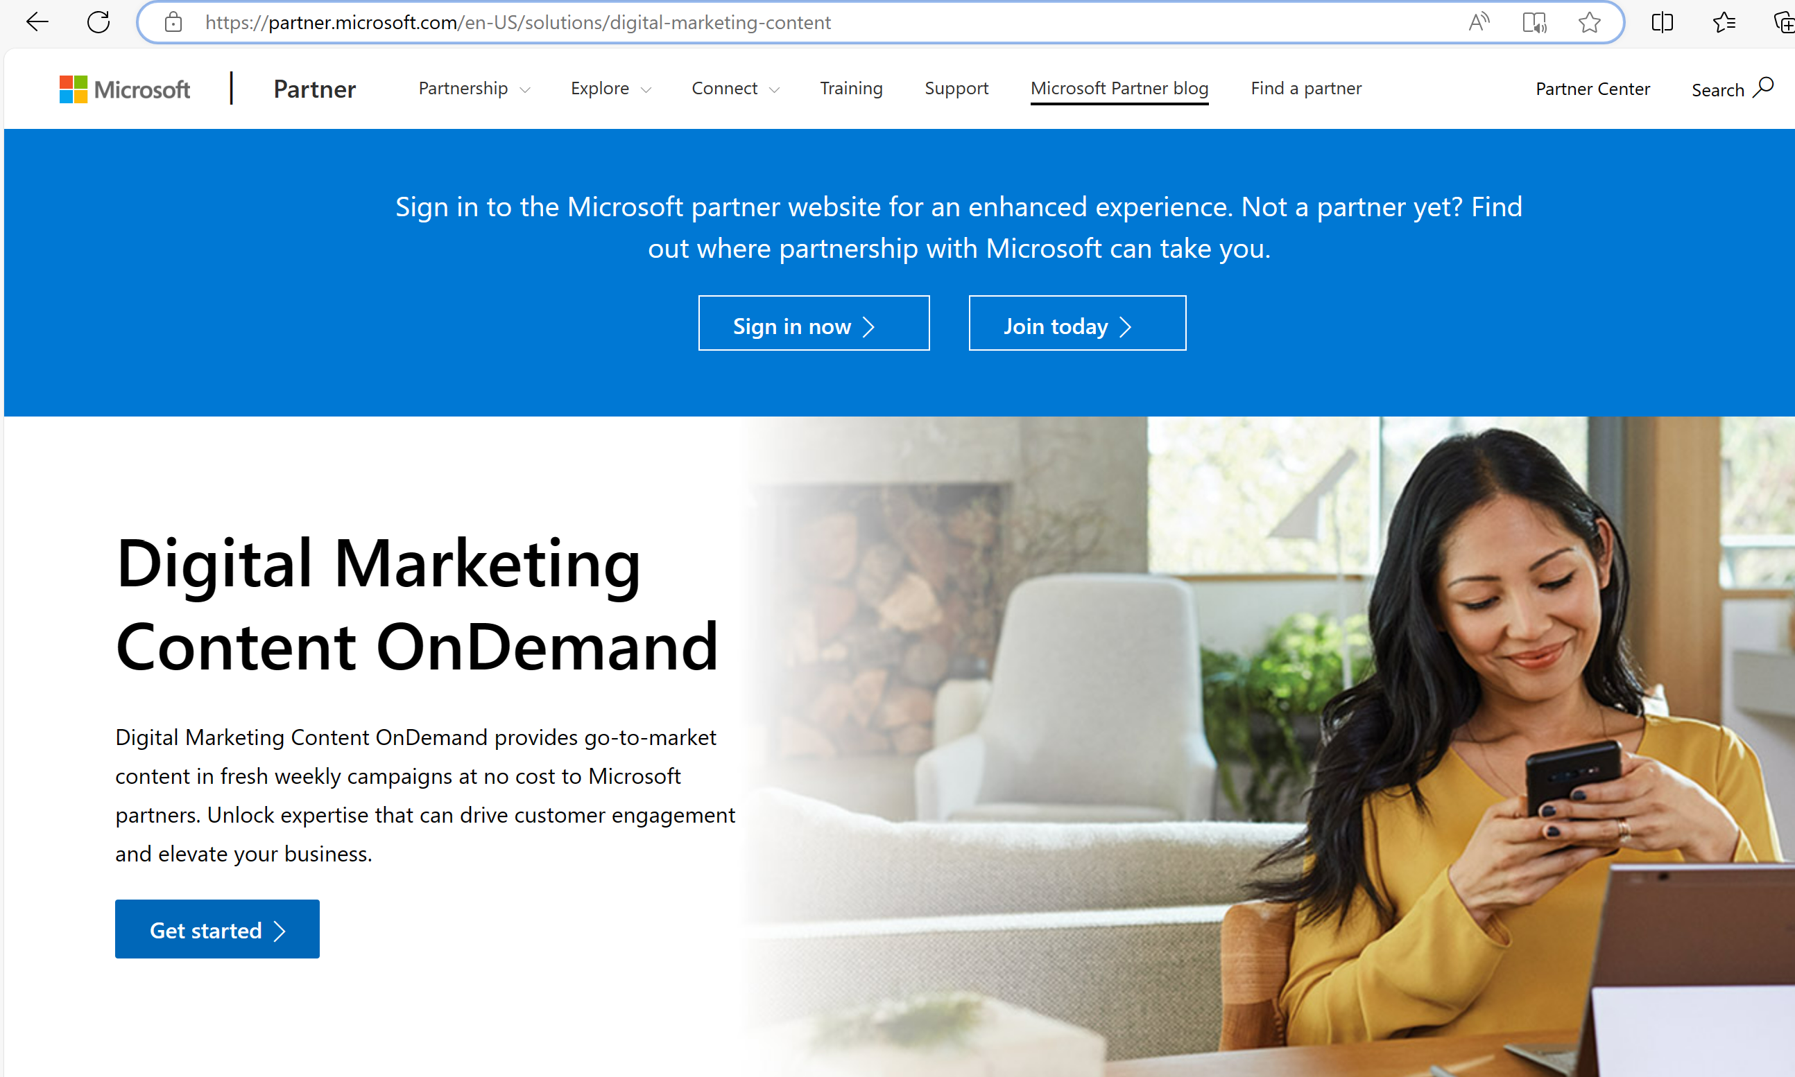
How to Use Campaigns with CloudAscent
5
To create your own campaign, leverage the cohort and solution play alignment to campaign content on http://aka.ms/smbgtm
Drive a ready-made campaign using DMC provided to partners free of cost from Microsoft. Campaigns are editable and can be scheduled for email and social media campaigns.

Slide 13
Upsell/Cross Sell Recommended Download Use
1
Scroll to the section on M365 upsell propensity, Filter on Act Now, Evaluate to get the high propensity customers
3
Align the High propensity Upsell/Cross Sell Customers with the correct Solution Play/Cohort, Use http://aka.ms/smbgtm to align cohorts and solution plays to Microsoft content
2
Leverage the Azure Upsell Model to expand customer product usage in Azure Next logical Workload. Filter on Act Now, Evaluate to get the high propensity customers
4
Login to DMC to use the existing campaign materials provided to partners free of cost from Microsoft. Use the marketing material associated to the solution play/cohort that you filtered on and run a campaign with these customers.

Slide 14
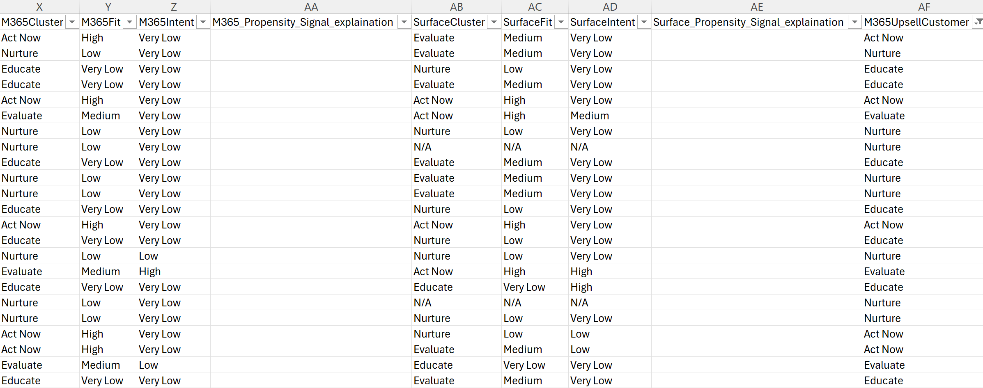
CloudAscent M365 Upsell
Example Upsell:
M365 Upsell
M365 Upsell is going to identify if a customer has purchased M365 in the past and is likely to purchase more of the same sku
1
Leverage the M365 Upsell Customer Column to see customers who have purchased M365 but are showing likelihood to purchase more.
Filter to the high propensity Act Now and Evaluate customers in the M365 Upsell Customer column.

Slide 15
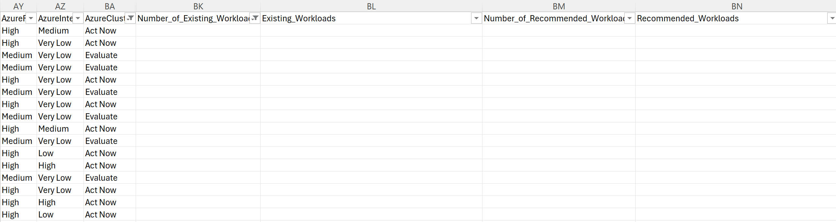
CloudAscent Azure Next Logical Workload
Azure NLW
Azure Next Logical Workload is going to identify what workload the customer is currently using and what workload we recommend targeting to them next.
2
Two Upsell Model’s exist within the CloudAscent data, M365 Upsell and Azure Next Logical Workload.
Azure Cluster is filtered to the high propensity clusters Act Now and Evaluate, filter out the blanks in existing workloads to get the list of existing Azure customers with the workloads they’re using and what we recommend selling to them next.
Alternatively filtering the existing workload to blank is going to provide a list of customers who have not purchased Azure and will be a high propensity candidate for Azure acquisition.

Slide 16
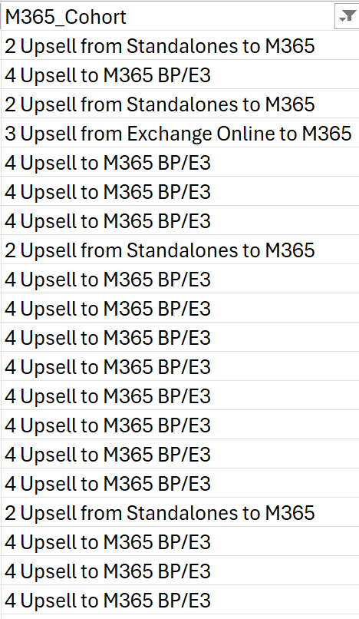
How to Use CloudAscent Upsell Models
M365 Download
3
Apply the upsell solution play/Cohort filters
Solution Plays/Cohort Names will indicate Upsell and NLW (Next Logical Workload) in the naming convention of the column.
For example, M365 identifies all upsell with Upsell at the start of the Cohort Name.
Azure Identifies upsell in the header using the Azure Next Logical Workload or NLW, for example, Migrate_and_Secure_Win_SQL_Server_Linux_Estate_NLW_Defender_for_Cloud_Go_Back
Pair the customer list with your internal contactability data and the M365 & Azure content available from Microsoft at https://aka.ms/smbgtm
Azure Download

Slide 17
How to Use Campaigns with CloudAscent
4
To create your own campaign, leverage the cohort and solution play alignment to campaign content on http://aka.ms/smbgtm
Drive a ready-made campaign using DMC provided to partners free of cost from Microsoft. Campaigns are editable and can be scheduled for email and social media campaigns.

Slide 18
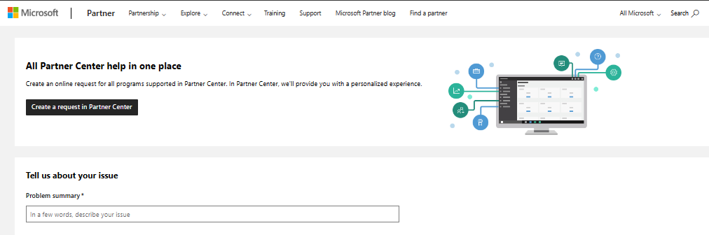
Support for accessing partner center
If you are having challenges accessing CloudAscent, please create a Support ticket.
A
A
Within Partner Center, in the top-left menu, select Help + support.
B
Explore Partner Center How-to docs or API for self-serve help. For help within a Workspace, select the Copilot icon to contact support.
B
C
Outside of partner center, navigate to the support tab on Partner.Microsoft.com and select create request in Partner Center or fill out the information requested for self-serve help.
C

Slide 19
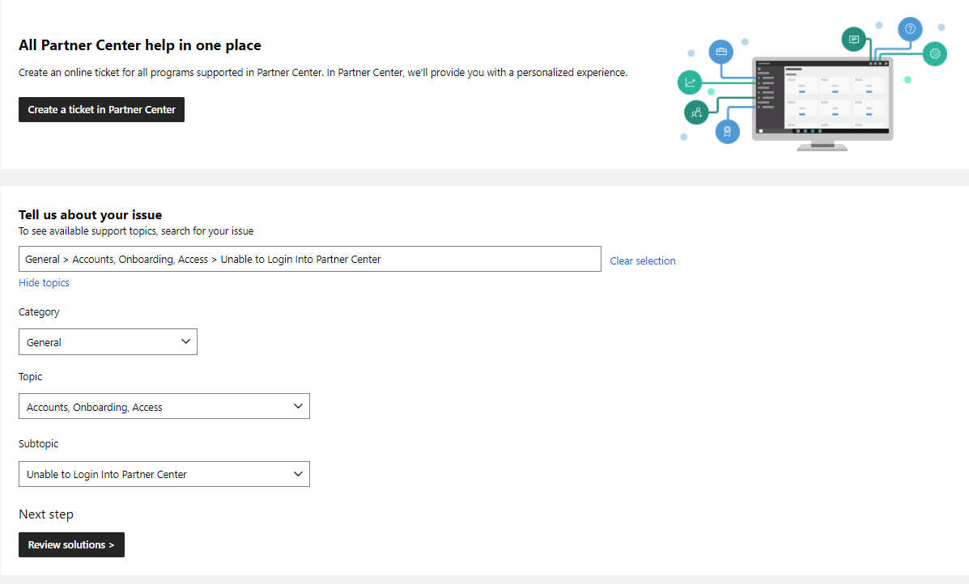
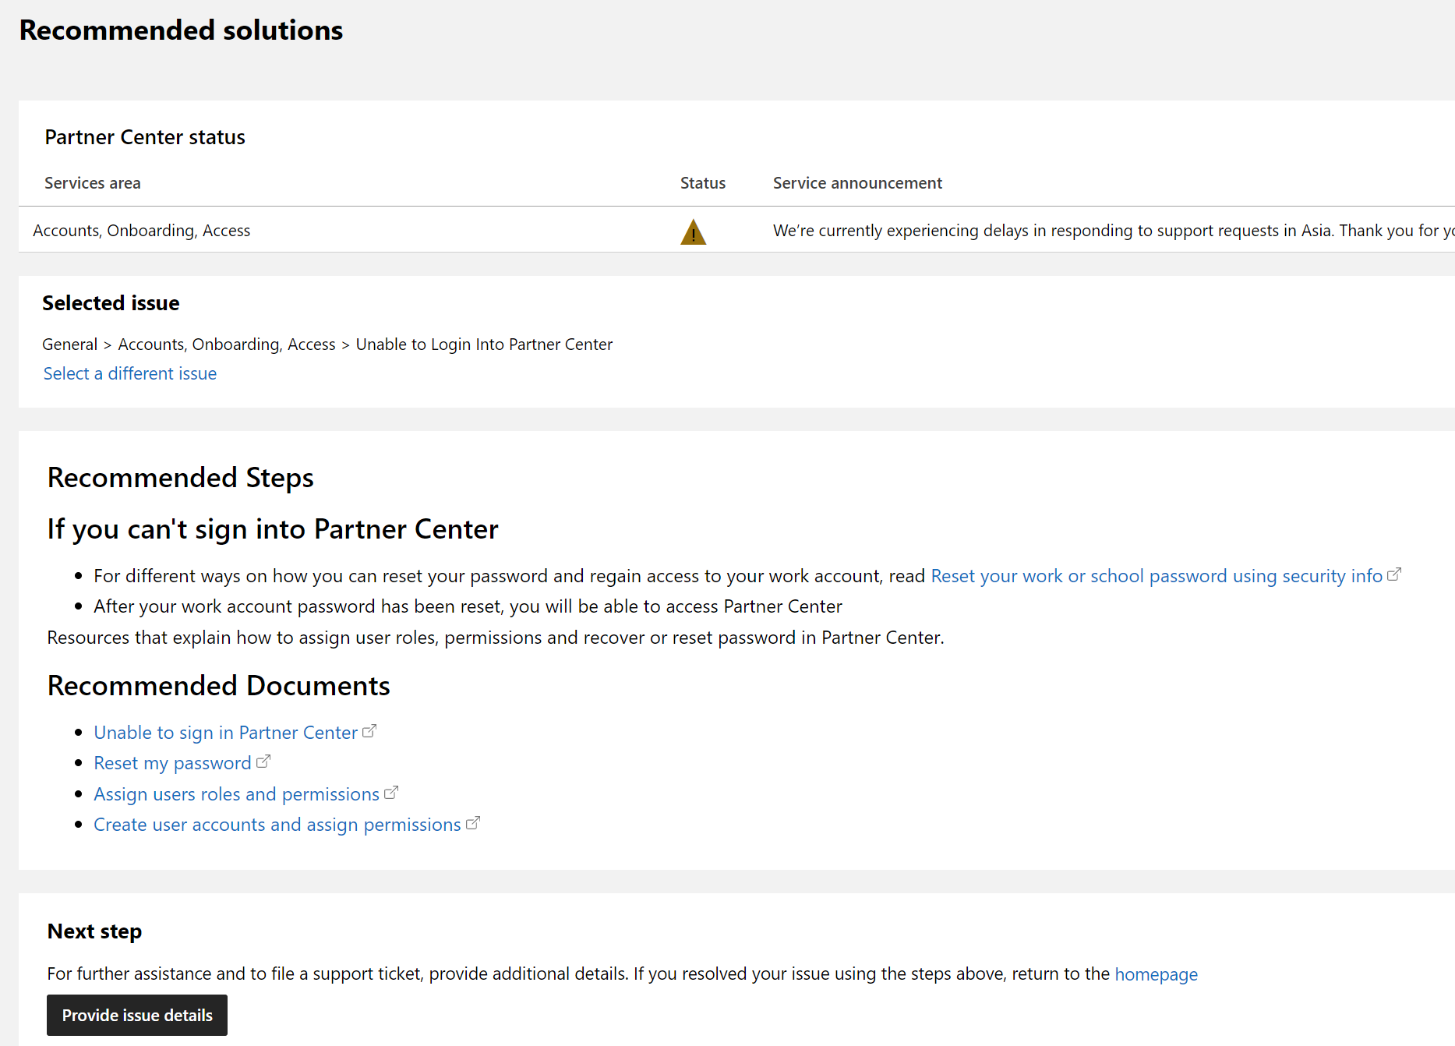
Support for accessing partner center
If you are not able to login to Partner Center, here is how to create a Support ticket.
A
A
Select unable to login into partner center by browsing through topics as shown and review resolutions.
B
If the recommended solutions do not resolve your issue, submit a ticket by selecting Provide issue details.
B

