Slide 1
Partner Spotlight: Overview
What is Partner Spotlight
The partner spotlight story is a feature for partners to share the benefits of working with nonprofit organizations and explain the services, offers, or solutions that benefitted the nonprofit sector and the partner.
Partner Spotlight Requirements
Have a story about the business value realized in working within the nonprofit sector, and/or a customer challenge, the solution, and the benefits to both the customer and the partner
Be a registered partner of the Microsoft AI Cloud Partner Program with a profile in the Partners for social impact (Non-Profit) - Microsoft Community Hub
Customer approval to be featured in the Partner Spotlight including a link to publicly available content
How to participate
Follow the instructions in slides 2 and 3 to create your three-minute recorded PowerPoint presentation
Send your completed presentation to tsipcomm@microsoft.com
Please note, we review recorded presentations on a monthly basis. If your presentation is selected, we’ll reach out with confirmation for usage.
Review previous Partner Spotlight examples here:
Tech for Social Impact Nonprofit Partner Spotlight (microsoft.com)

Slide 2




Partner Spotlight: Getting Started
  Complete the Partner/Customer Success Story Template on slide 3
  Create a three-minute recorded PowerPoint presentation:
  Follow the instructions on how to record here
  Refer to slide 4 for additional recording tips
  Submit your completed slide to tsipcomm@microsoft.com. Provide the partner’s name, contact information and presenter’s name
Questions? Reach out to tsipcomm@microsoft.com

Slide 3
Partner/Customer Success Story Template
<Insert Title>
Add partner logo here
Challenge
Add text here: Include details on the Customer business challenge
Solution
Add text here: Include details on the technology the partner used to solve the challenge
Benefits
Add text here: Include benefits to both the nonprofit customer and to the partner
Include image of the speaker presenting the recording here
Add customer quote and logo here
Reminder: Any work showcased in a Partner Spotlight video requires a publicly published case study URL (video, blog, etc.) and the partner must have their customer's approval to talk about the engagement
Add link to the published customer story here
** Add Microsoft disclaimer here

Slide 4
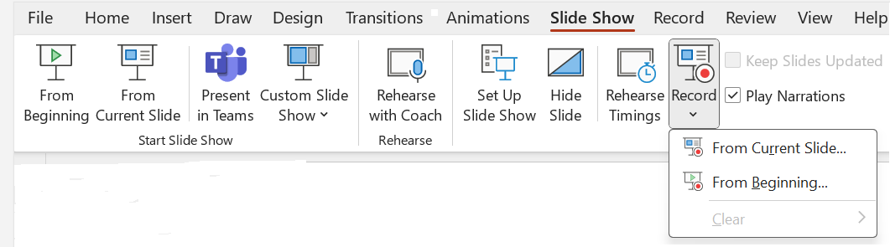
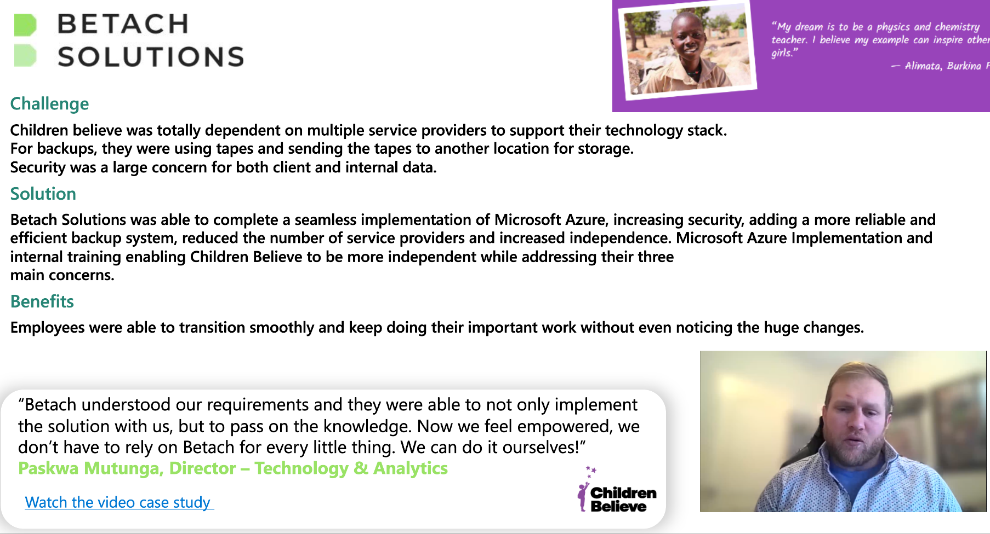
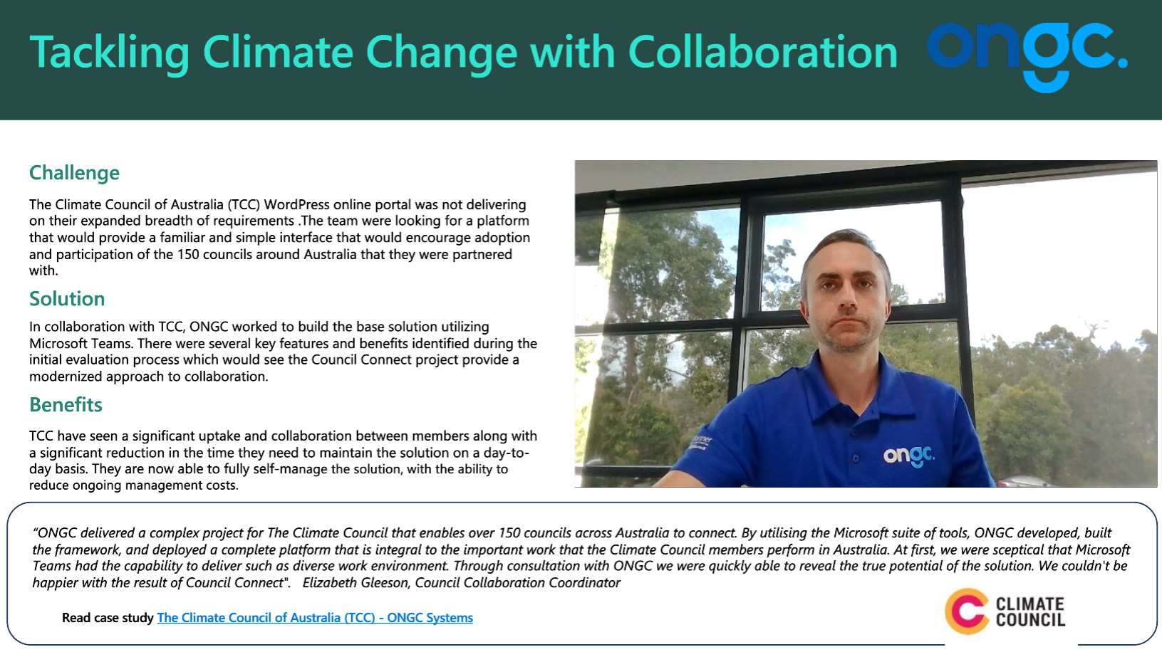
Partner Spotlight: Recording Tips
Create the recording within PowerPoint
Do not use animations
Limit your presentation to a maximum of 3 minutes.
Go to Slide Show > Click Record > Select From the Current Slide
Audio record each slide individually
Have the audio load automatically
Capture an image of the speaker presenting and include on the slide
Questions? Contact tsipcomm@microsoft.com

