Slide 1
Cipherspaces/Darknets:
An overview of attack strategies
Adrian Crenshaw

Slide 2

About Adrian
I run Irongeek.com
I have an interest in InfoSec education
I don’t know everything - I’m just a geek with time on my hands
(ir)Regular on the ISDPodcast
http://www.isdpodcast.com
Researcher for Tenacity Institute
http://www.tenacitysolutions.com
Notes:
Take a note from Johnny Long’s book, and Bruce Potter’s book.

Slide 3
A little background…
Darknets: There are many definitions, but the one I’m working from is “anonymizing networks”
Use of encryption and proxies (some times other peers) to obfuscate who is communicating to whom
Sometimes referred to as Cipherspace
(I love that term)
Tor and I2P will be my reference examples, but there are others

Slide 4
…and some notes
Things get subtle
Terms vary from researcher to researcher
Many weaknesses are interrelated
Other anonymizing networks: Morphmix/Tarzan/Mixminion/Mixmaster/JAP/
MUTE/AntsP2P/Haystack
Focus on Tor and I2P for illustrations when needed
Academic vs. real world

Slide 5
Threat Model and Adversaries matter
Threat Model: You can’t protect against everything!
  Some protocols may be lost causes
  Users may do something to reveal themselves
  Does an attack reveal the Client/Host or just reduces the anonymity set?
Active vs. Passive attackers
Location, Location, Location:
  Internal vs. External
Adversaries: Vary by power and interest
  Nation States
    Western Democracies vs. Others
  Government agency with limited resources
  ISP/Someone with a lot of nodes on the network
  Private interests groups (RIAA/MPAA)
  Adrian (AKA: Some shmuck with time on his hands)

Slide 6




Tor: The Onion Router
Layered encryption
Bi-directional tunnels
Has directory servers
Mostly focused on out proxying to the Internet
More info at https://www.torproject.org
Internet Server
Directory Server

Slide 7

I2P
Unidirectional connections: In tunnels and out tunnels
Information about network distributed via distributed hash table (netDB)
Layered encryption
Mostly focused on anonymous services
More info at http://www.i2p2.de/

Slide 8
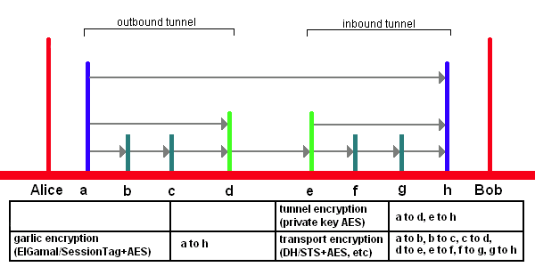
I2P Encryption Layers
EIGamal/SessionTag+AES from A to H
Private Key AES from A to D and E to H
Diffie–Hellman/Station-To-Station protocol + AES
Image from http://www.i2p2.de/

Slide 9




Silly Garlic Routing
Animation
Make a Garlic message to multiple destinations.
Then send it.
Unpack it and send individual cloves to their destinations.
Brian
Calvin
Dave
Adrian

Slide 10
Un-trusted exit points
You are only as anonymous as the data you send!

Slide 11
Overview
Mostly Tor centric:
Is the exit point for traffic looking at the data?
Traffic may be encrypted inside the network, but not once it is outbound!

Slide 12
Incidents
Dan Egerstad and the “Embassy Hack”
http://www.wired.com/politics/security/news/2007/09/embassy_hacks
Tons of passwords sent via plain text protocols (POP3/SMTP/HTTP Basic/Etc)
Moxie Marlinspike did something similar with SSLStrip
http://intrepidusgroup.com/insight/2009/02/moxie-marlinspike-un-masks-tor-users/

Slide 13






Do you trust your exit node?
I could just look at the traffic, or modify it and send it back as part of another type of attack.

Slide 14
Mitigation
Tor is for anonymity, not necessarily security
Use end-to-end encryption/Don’t use plain-text protocols
Plain text protocols that send usernames/email addresses in the clear are not very anonymous now are they?

Slide 15
DNS Leaks, Other Protocol leaks and application layer problems

Slide 16
Overview
Does all traffic go though the proxy?
DNS Leaks are a classic example
Badly configured proxy setting could lead some types of traffic to go elsewhere (outside of cipherspace)
Snooper can use web bugs to figure out your location
http://www.irongeek.com/i.php?page=security/webbugs
HTTPS is a good example, but plugins can also be an issue
Application level stuff in general is a problem
Javascript is just hosed as far as reducing you anonymity set
See: Gregory Fleischer, DEFCON 17: Attacking Tor at the Application Layer

Slide 17
DNS Leaks
Monitored DNS Server
If I don’t use the proxy for DNS, I may send the query to a DNS server. It won’t see my traffic to/from the destination, but may now know I’m visiting someplace.com/.onion/.i2p
DNS
Query

Slide 18
Mitigating DNS Leaks
Sniff for traffic leaving your box on port 53. The libPcap capture filter:
port 53
should work in most cases.
In Firefox, under about:config set network.proxy.socks_remote_dns to true
Torbutton should help
Other applications vary
May have to firewall off 53 in some cases
May want to edit torrc, and add:
DNSPort 53
AutomapHostsOnResolve 1
Then set your box’s DNS to point to 127.0.0.1

Slide 19

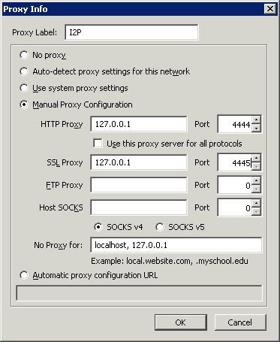
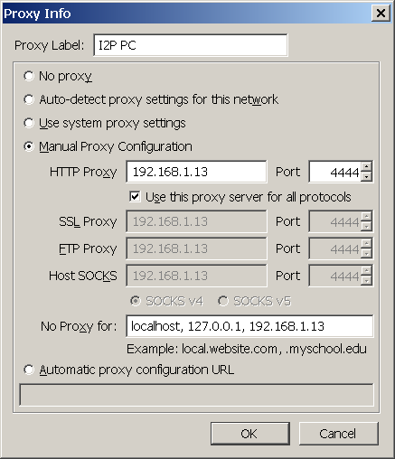

Grabbing content outside of the Darknet
I host an eepSite, but not all of the content is HTTP! Could be an image over HTTPS, or a bad plugin.

Slide 20

Slightly Related: Cookies/Supercookies/Etc
I see the same session cookie as one I handed out over the public Internet. Guess I know who this is!
Just checked out this site via the public Internet, now I want to use a proxy to look at it.
Cookie image from brainloc on sxc.hu via Wikipedia

Slide 21
Make hidden server contact you over public Internet
Let’s see if the hidden server app is vulnerable to an exploit (buffer overflow/web app shell exec/etc).
Send a payload that contacts an IP I monitor.
Exploit &
Payload

Slide 22
Another example, Bittorrent Issues
Tracker
If Tor is only being used for contacting the tracker, I could just watch Announce Messages &
Extension Protocol Handshakes to extract real IPs.
DHT
(Distributed Hash Table)
Nodes
Again, If Tor is only being used for contacting the tracker and SSL is not used, I could change the returned peers list to point to me as one of the sources and watch for the outside contact, then try to correlate an IP based on PeerID/port.
Even if the peer traffic is sent over Tor, if the DHT is used the IP may still be revealed because the UDP packets are not sent over Tor. I can scrape the DHT myself, and correlate an IP based on the PeerID/port I saw going through my exit point.
Evil Exit
Point
I may then be able to infer the sender/receiver of other non-Bittorrent traffic because of Tor’s shared circuits.
Announce Message/
Extension Protocol Handshake
UDP DHT
Message
See this paper for more info:
Compromising Tor Anonymity Exploiting P2P Information Leakage
Pere Manils, Abdelberi Chaabane, Stevens Le Blond,
Mohamed Ali Kaafar, Claude Castelluccia, Arnaud Legout, Walid Dabbous
http://hal.inria.fr/docs/00/47/15/56/PDF/TorBT.pdf

Slide 23
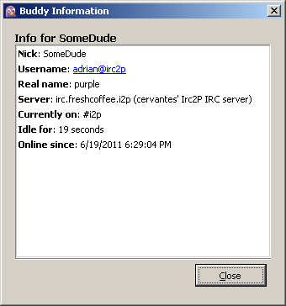
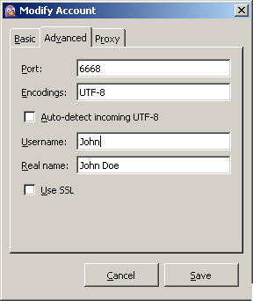
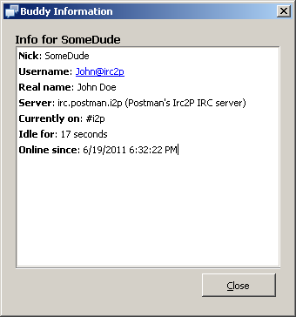
Yet Another Example:
IRC Ident

Slide 24
General Mitigations
Client wise:
Make sure your browser is set to send all traffic though the darknet, or none at all
Look into firewall rules
Limit plugins used
Use a separate browser
Check against:
http://decloak.net/
http://panopticlick.eff.org/
Hidden server wise:
Patch your stuff
Don’t run on a box that routes to the Internet

Slide 25
Attacks on centralized resources/infrastructure attacks/DoS attacks

Slide 26
Overview
Not so much against individual nodes, but the network in general
Whole bunch of categories, not comprehensive:
  Starvation attacks
  Partition attacks
  Flooding
Standard DDoS attacks against resources inside and outside of the network (if going though the network) are likely to be soaked by other peers
Shared known infrastructure can be a problem
Total (or at least severe) blocking of the Internet

Slide 27
Incidents
China blocked access to the core directory servers of Tor on September 25th 2009
https://blog.torproject.org/blog/tor-partially-blocked-china
Other blocking of Internet access. (Egypt, Libya, Iran)

Slide 28
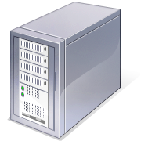

DoS of directory servers
Tor Directory
Server
?
?
?

Slide 29
Mitigation
Bridge nodes (Tor)
Distributed infrastructure (I2P)
  Taking out dev site would still be an issue
Distributed Hash Table
Protocol obfuscation
Total/Severe blocking will take a bit more:
(see next slide)

Slide 30



Mesh/Store and forward

Slide 31
For more info on mesh networks
Needs a clear front runner for setting up such a system
Wikipedia if nothing else
http://en.wikipedia.org/wiki/Wireless_mesh_network
Village Infrastructure in a Kit-Alpha (VIKA) Project
http://www.cuwin.net/node/325
U.S. Underwrites Internet Detour Around Censors
http://www.nytimes.com/2011/06/12/world/12internet.html?_r=2&pagewanted=all

Slide 32
Clock based attacks

Slide 33
Overview
Some protocols allow you to check the remote system’s clock
Clock difference could be an issue
Major difference are easy to spot
Minor clock issues may need statistical analysis

Slide 34
Incidents
For skew, see:
Steven J. Murdoch, "Hot or Not: Revealing Hidden Services by their Clock Skew"
University of Cambridge, Cambridge, 2006
http://www.freehaven.net/anonbib/cache/HotOrNot.pdf
I2P Clock differences in I2P
http://www.irongeek.com/i.php?page=security/darknets-i2p-identifying-hidden-servers

Slide 35
Clock Issues
It’s 2:00PM UTC
Hey? What time is it?
Tor Hidden server or I2P eepSite

Slide 36
Clock Differences
Time Difference | Retrieval Time | Host | Header
40.417 | 0.436 | 89.31.112.91 | Apache/2.2.13 (Linux/SUSE)
50.294 | 10.549 | medosbor.i2p | Apache/2.2.13 (Linux/SUSE)
3.418 | 0.35 | 85.229.85.244 | Apache/2.2.15 (Debian)
4.325 | 5.059 | jonatan.walck.i2p | Apache/2.2.15 (Debian)
-4325.58 | 0.353 | 84.55.73.228 | Apache/2.2.3 (CentOS)
-4321.66 | 8.946 | ipredia.i2p | Apache/2.2.3 (CentOS)
4488.434 | 0.702 | 130.241.45.216 | Apache/2.2.9 (Debian) PHP/5.2.6-1+lenny8 with Suhosin-Patch
4490.365 | 4.894 | error.i2p | Apache/2.2.9 (Debian) PHP/5.2.6-1+lenny8 with Suhosin-Patch
2.407 | 4.89 | bolobomb.i2p | Apache/2.2.9 (Debian) PHP/5.2.6-1+lenny9 with Suhosin-Patch mod_ssl/2.2.9 OpenSSL/0.9.8g
2.421 | 0.091 | 83.222.124.19 | Apache/2.2.9 (Debian) PHP/5.2.6-1+lenny9 with Suhosin-Patch mod_ssl/2.2.9 OpenSSL/0.9.8g
3.43 | 0.282 | 188.40.181.33 | lighttpd/1.4.22
5.366 | 2.901 | docs.i2p2.i2p | lighttpd/1.4.22
6.274 | 3.673 | zzz.i2p | lighttpd/1.4.22
53.415 | 0.26 | 93.174.93.93 | Microsoft-IIS/6.0
54.404 | 3.92 | colombo-bt.i2p | Microsoft-IIS/6.0
3.287 | 0.531 | www.i2p2.i2p | nginx/0.6.32
3.429 | 0.285 | 46.4.248.202 | nginx/0.6.32
11.323 | 8.989 | lurker.i2p | nginx/0.7.65
12.433 | 8.882 | 178.63.47.16 | nginx/0.7.65

Slide 37
Mitigation
Attack can be hard to pull off because of network jitter
Set clocks with a reliably and often used NTP server
Some mitigation may take place in the darknet protocol itself

Slide 38
Metadata in files

Slide 39
Overview
Metadata is data about data
Just a few files types that contain metadata
  JPG
  EXIF (Exchangeable image file format)
  IPTC (International Press Telecommunications Council)
  PDF
  DOC
  DOCX
  EXE
  XLS
  XLSX
  PNG
  Too many to name them all
Things stored: User names, edits, GPS info, network paths, MAC addresses in odd cases. It all depends on the file format.

Slide 40



Incidents: Pwned by Metadata
Cat Schwartz
Is that an unintended thumbnail in your EXIF data, or are you just happy to see me?
Dennis Rader (BTK Killer)
Metadata in a Word DOC he sent to police had the name of his church, and last modified by “Dennis” in it.
Darkanaku/Nephew chan
A user on 4chan posts a pic of his semi-nude aunt taken with an iPhone, Anonymous pulls the EXIF GPS info from the file and hilarity ensues.
More details can be on the following VNSFW site:
http://encyclopediadramatica.com/User:Darkanaku/Nephew_chan
http://web.archive.org/web/20090608214029/http://encyclopediadramatica.com/User:Darkanaku/Nephew_chan

Slide 41
Mitigation
Well, clean out the metadata, duh!
Apps vary on how to do it

Slide 42
local attacks
(at this point, it is already probably a lost cause)

Slide 43

Overview
If they have access to the local box, your hosed
Comes down to mostly traditional forensics
  Data on hard drive
  Cached data and URLs
  Memory Forensics

Slide 44
Mitigations
Anti-forensics
http://www.irongeek.com/i.php?page=videos/anti-forensics-occult-computing
Live CD/USB, but see Andrew Case’s work:
https://media.blackhat.com/bh-dc-11/Case/BlackHat_DC_2011_Case_De-Anonymizing_Live_CDs-wp.pdf
Full hard drive encryption

Slide 45
Sybil attacks
Sock puppetry

Slide 46
Overview
Ever heard of Sybil attacks?
Think sock puppet, one entity acting as many
May allow for control of routing, elections, etc.
Makes many of the other attacks easier

Slide 47

Sock puppetry/Sybil
Heed my route vote and info!
Random walk this way!
Yay democracy!

Slide 48
Mitigation
No absolute fixes
Make it cost something to have nodes (hashcash)
IP restrictions:
Both Tor and I2P restrict peering between IPs on the same /16
Central infrastructure may be more resilient against Sybil attacks (but has other issues)
Peering/Profiling strategies
SybilLimit/SybilGuard/SybilInfer

Slide 49
Traffic Analysis Attacks
First/Last in chain attacks
Tagging attacks
Timing attacks

Slide 50
Overview
There’s much focus on this in academia, but I imagine application layer flaws are more likely to snag someone
So many subtle variation on profiling traffic
Could be:
  Timing of data exchanges
  Amount of traffic
  Tagging of traffic by colluding peers
Generally takes a powerful adversary
Hard to defeat in “low latency” networks

Slide 51
I2P one-way tunnel mesh network: Logical view

Slide 52
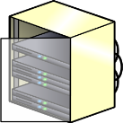
I2P one-way tunnel mesh network:
ISP view

Slide 53

End point and exit point
Client
8MB
Client
Client
Client
5MB

Slide 54
Timing Correlation
I could just watch the timings.
DoS Attack
Client
Or even just change the load on the path.
DoS Attack
DoS outside host to affect traffic.
Client
Pulse the data flows myself.
Client

Slide 55
Mitigation
More routers
More cover traffic
(smaller needle in a larger haystack)
Entry Guards for first hop
One way tunnels
Short lived tunnels may help
Better peer profiling
Signing of the data
Fixed speeds
Padding and Chaff
Non-trivial delays and Batching

Slide 56
Intersection/Correlation Attacks

Slide 57
Overview
Could be as simple as knowing who is up when a hidden service can be accessed
Techniques can be used to reduce the search set
Application flaws and information leaks can narrow the anonymity set
Harvesting attacks

Slide 58
Correlation
Is the hidden service up?
Tor Hidden server or I2P eepSite
Ping
Ping
Is this suspect node up?

Slide 59
Cut down needed checks
1. What server software are you running an eepSite on?
2. Harvest as many peer IPs as I can.
eepSite Host
3. Is there a web service on the public facing IP using the same daemon?
Request/Response
Request/Response
4. Does it respond to the same Vhost request?
5. If so, yippy! Found you!

Slide 60
Mitigation
More nodes
Give less data that could be used to reduce the anonymity set
Make harvesting/scrapping attacks harder
Checkout “De-anonymizing I2P” paper and talk I’ll link to later

Slide 61
Links
Selected Papers in Anonymity
http://www.freehaven.net/anonbib/
I2P’s Threat Model Page
http://www.i2p2.de/how_threatmodel.html
General Darknets Talk
http://www.irongeek.com/i.php?page=videos/aide-winter-2011#Cipherspace/Darknets:_anonymizing_private_networks
De-anonymizing I2P
http://www.irongeek.com/i.php?page=security/darknets-i2p-identifying-hidden-servers
http://www.irongeek.com/i.php?page=videos/identifying-the-true-ip-network-identity-of-i2p-service-hosts-talk-adrian-crenshaw-blackhat-dc-2011

Slide 62
Thanks
Conference organizers for having me
Tenacity for helping get me to Defcon
By buddies from Derbycon and the ISDPodcast
Open Icon Library for some of my images
http://openiconlibrary.sourceforge.net

Slide 63
Events
DerbyCon 2011, Louisville Ky
Sept 30 - Oct 2
http://derbycon.com
Louisville Infosec
http://www.louisvilleinfosec.com
Other Cons:
http://skydogcon.com
http://hack3rcon.org
http://phreaknic.info
http://notacon.org
http://outerz0ne.org
Notes:
Beg for hardware donations. ☺

Slide 64
Questions?
42

